Slide 1
Phantom
transfer function

Slide 2
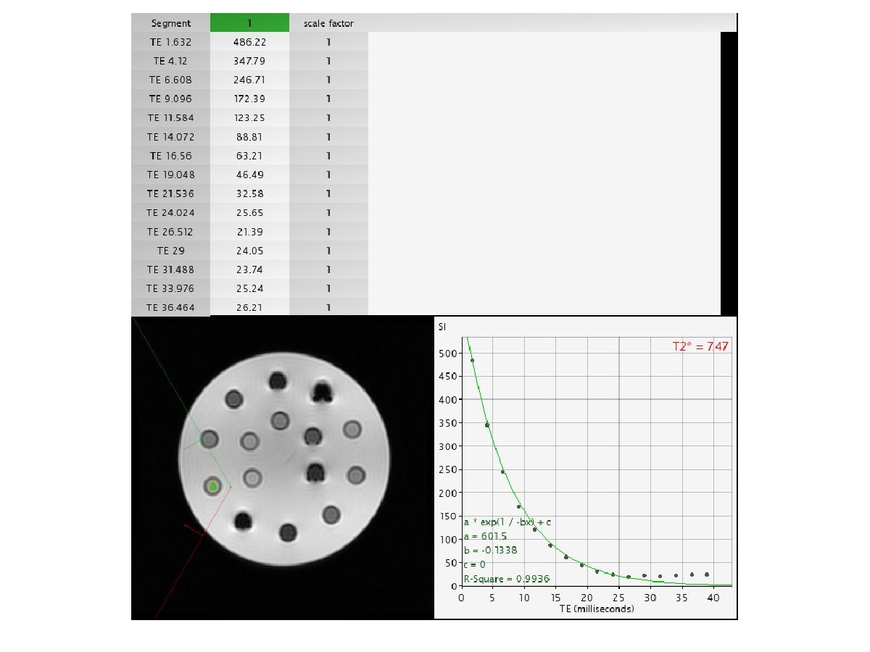
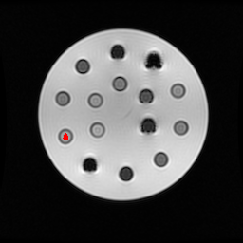


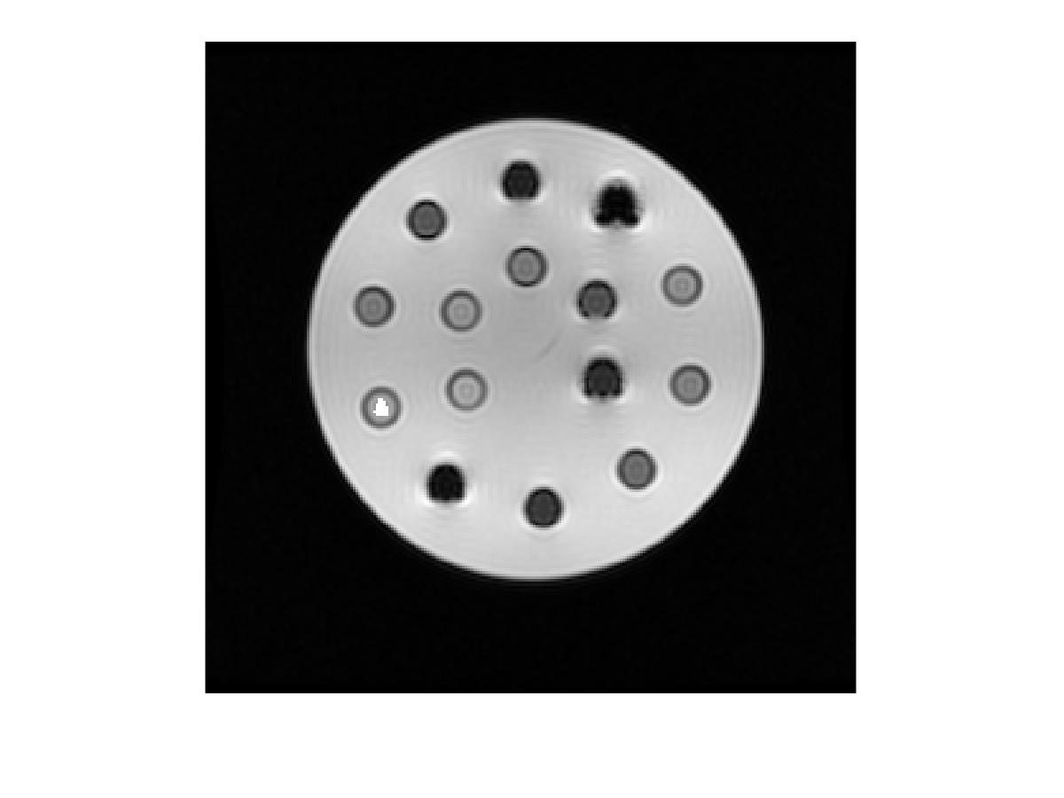
Transfer ROI from CMRtools to 1.5T
DICOM from CMRtools
DICOM 1.5 Tesla
Transfer ROI
Resize ROI for DICOM 1.5 Tesla
Extract ROI by Green Colour

Slide 3
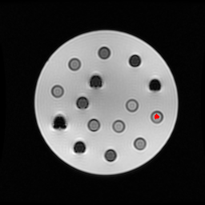
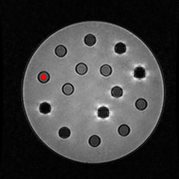
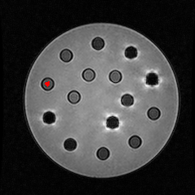
Transfer ROI from 1.5T to 3T
resize and get position on DICOM 1.5 Tesla
get position on
DICOM 3 Tesla
Find Angle
Translation to position
on DICOM 3 Tesla
ROI from DICOM 1.5 Tesla
Rotation Matrix

Slide 4
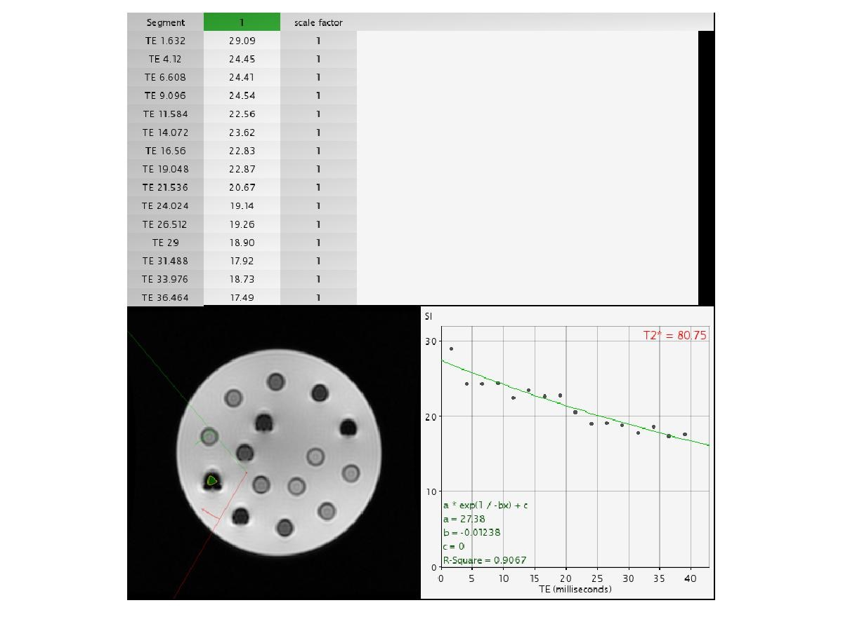




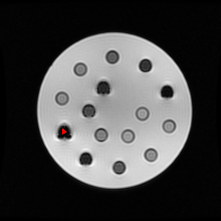
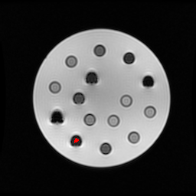
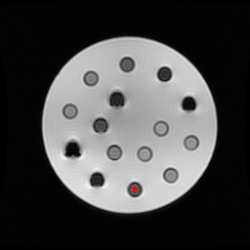
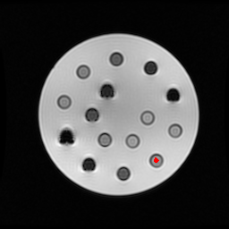
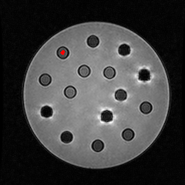
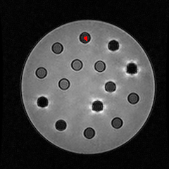
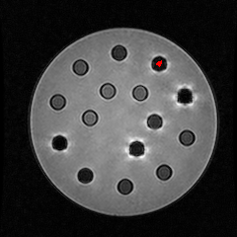
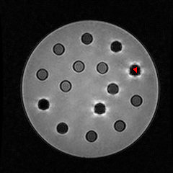
Result Transfer ROI
CMRtools
CMRtools
CMRtools
CMRtools
CMRtools
1.5T
1.5T
1.5T
1.5T
1.5T
3T
3T
3T
3T
3T

Slide 5
Improve MRIM
T2* value (ms) 1.5T
position | 1 | 2 | 3 | 4 | 5 | 6 | 7 | 8 | 9 | 10 | 11 | 12 | 13 | 14 | 15
week1 | 7.18 | 3.61 | 2.01 | 1.74 | -34.93 | 8.89 | 4.23 | 2.23 | 1.24 | 5.07 | 13.98 | 7.42 | 3.62 | 1.92 | 1.53
week2 | 7.47 | 3.64 | 1.94 | 1.58 | 12.37 | 9.49 | 4.37 | 2.20 | 1.30 | 6.03 | 14.51 | 7.16 | 3.78 | 2.42 | 1.59
week3 | 7.63 | 3.68 | 1.80 | 1.65 | 55.78 | 9.92 | 4.55 | 2.31 | 1.18 | 4.35 | 14.97 | 7.73 | 3.91 | 2.33 | 1.64
week4 | 7.50 | 3.67 | 2.09 | 1.52 | 17.98 | 9.96 | 4.50 | 2.25 | 1.14 | 6.02 | 14.20 | 7.39 | 3.98 | 2.38 | 1.50
week5 | 7.56 | 3.64 | 1.93 | 1.60 | 16.71 | 9.74 | 4.40 | 2.28 | 1.23 | 4.54 | 14.63 | 7.64 | 3.75 | 2.44 | 1.56
week6 | 7.44 | 3.63 | 2.05 | 1.69 | -213.31 | 9.49 | 4.48 | 2.27 | 1.12 | 3.73 | 14.33 | 7.32 | 3.60 | 2.43 | 1.60
week7 | 7.83 | 3.87 | 1.99 | 1.54 | 12.95 | 10.00 | 4.46 | 2.25 | 1.19 | 4.49 | 14.87 | 7.96 | 3.99 | 2.45 | 1.45
week8 | 8.15 | 4.24 | 2.13 | 1.42 | 7.24 | 10.18 | 4.57 | 2.26 | 1.24 | 2.78 | 15.81 | 8.28 | 4.20 | 2.43 | 1.50
week9 | 8.38 | 4.17 | 2.18 | 1.54 | 6.49 | 10.20 | 4.69 | 2.42 | 1.20 | 3.35 | 15.85 | 8.51 | 4.18 | 2.43 | 1.43
week10 | 8.01 | 3.85 | 1.93 | 1.33 | 7.15 | 9.98 | 4.69 | 2.26 | 1.16 | 2.10 | 14.63 | 7.75 | 4.03 | 2.22 | 1.35
week11 | 7.78 | 3.77 | 1.96 | 1.35 | 6.20 | 9.84 | 4.41 | 2.40 | 1.14 | 2.18 | 14.15 | 7.67 | 3.99 | 2.39 | 1.41
week12 | 7.94 | 3.93 | 1.99 | 1.33 | 6.61 | 9.94 | 4.50 | 2.35 | 1.17 | 2.11 | 14.93 | 7.88 | 4.10 | 2.22 | 1.42
week13 | 7.75 | 3.86 | 2.11 | 1.31 | 9.39 | 10.21 | 4.57 | 2.59 | 1.26 | 2.06 | 14.82 | 7.66 | 3.99 | 2.38 | 1.51
week14 | 7.84 | 3.95 | 2.09 | 1.73 | 8.14 | 10.37 | 4.82 | 2.52 | 1.31 | 2.75 | 15.02 | 8.00 | 4.01 | 2.50 | 1.56
week15 | 7.25 | 3.62 | 2.06 | 1.72 | 13.60 | 9.89 | 4.42 | 2.32 | 1.18 | 2.79 | 13.81 | 7.09 | 3.56 | 2.39 | 1.64
mean correct value | 7.72 | 3.81 | 2.02 | 1.54 | - | 9.87 | 4.51 | 2.33 | 1.20 | - | 14.70 | 7.70 | 3.91 | 2.35 | 1.51

Slide 6
Improve Transfer Function
T2* value (ms) 3T
position | 1 | 2 | 3 | 4 | 5 | 6 | 7 | 8 | 9 | 10 | 11 | 12 | 13 | 14 | 15
week1 | 5.46 | 2.82 | 1.65 | 1.42 | -20.90 | 5.63 | 2.94 | 2.15 | 1.02 | -7.69 | 13.83 | 6.02 | 2.86 | 1.60 | 1.17
week2 | 6.56 | 3.58 | 1.51 | 1.73 | -55.54 | 7.53 | 4.29 | 2.34 | 1.27 | -21.28 | 11.24 | 5.64 | 4.09 | 1.06 | 1.14
week3 | 6.73 | 3.62 | 1.50 | 1.52 | -8.54 | 9.06 | 3.09 | 2.27 | 1.14 | -4.03 | 13.39 | 6.78 | 3.73 | 1.20 | 1.12
week4 | 6.95 | 3.50 | 1.67 | 1.45 | -14.40 | 8.37 | 3.67 | 1.72 | 1.03 | -2.09 | 14.46 | 6.40 | 4.06 | 1.37 | 1.12
week5 | 7.77 | 3.45 | 1.38 | 2.94 | -2.72 | 9.58 | 3.77 | 1.81 | 1.15 | -3.33 | 12.68 | 6.18 | 3.26 | 1.86 | 1.61
week6 | 6.65 | 3.25 | 0.97 | 0.98 | -105.13 | 6.49 | 4.78 | 1.97 | 1.08 | -2.91 | 10.01 | 5.64 | 3.51 | 1.47 | 1.58
week7 | 6.98 | 3.50 | 1.37 | 1.23 | -1.99 | 8.24 | 3.90 | 1.95 | 0.90 | 8.94 | 10.32 | 6.33 | 3.58 | 1.46 | 1.41
week8 | 8.44 | 3.78 | 1.21 | 0.94 | 7.65 | 9.76 | 3.03 | 1.62 | 0.99 | -16.82 | 18.75 | 7.42 | 3.61 | 1.73 | 0.99
week9 | 6.51 | 3.41 | 1.31 | 1.02 | 7.00 | 6.12 | 3.50 | 1.62 | 1.01 | 2.40 | 9.96 | 6.11 | 3.39 | 1.50 | 1.13
week10 | 5.58 | 3.24 | 1.08 | 2.60 | -5.19 | 8.66 | 3.11 | 1.60 | 1.26 | 100.45 | 7.52 | 4.99 | 2.66 | 1.75 | 1.78
week11 | 6.09 | 3.41 | 1.39 | 0.86 | 8.01 | 11.41 | 3.27 | 1.63 | 0.88 | 2.68 | 10.09 | 6.43 | 3.35 | 1.28 | 1.12
week12 | 6.68 | 3.34 | 1.25 | 1.22 | -336.24 | 11.85 | 4.04 | 1.92 | 1.17 | -7.05 | 11.62 | 6.33 | 3.55 | 1.43 | 1.48
week13 | 7.34 | 3.40 | 1.33 | 1.33 | -3.18 | 12.54 | 4.17 | 1.67 | 1.04 | 8.40 | 11.00 | 6.49 | 3.32 | 1.53 | 1.03
week14 | 6.92 | 3.43 | 1.36 | 0.68 | 3.69 | 8.20 | 3.53 | 1.64 | 1.08 | 0.74 | 12.71 | 6.25 | 3.56 | 1.75 | 0.85
week15 | 5.33 | 3.93 | 1.49 | 1.52 | -3.89 | 11.06 | 3.41 | 2.01 | 1.26 | -2.00 | 10.16 | 6.11 | 3.93 | 1.41 | 1.29
mean correct value | 6.67 | 3.44 | 1.36 | 1.13 | - | 8.97 | 3.63 | 1.86 | 1.08 | 0.74 | 11.85 | 6.21 | 3.50 | 1.49 | 1.17

Slide 7
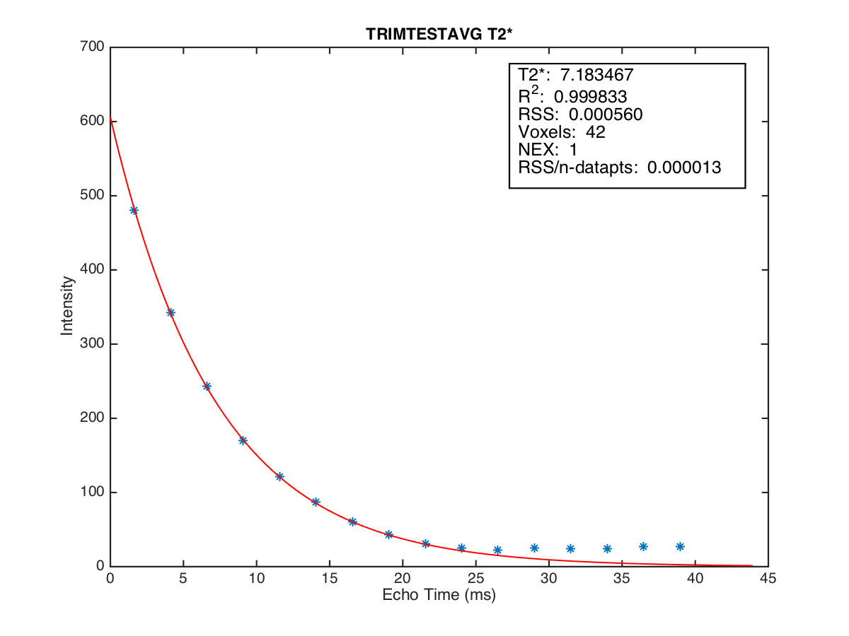
Improve Transfer Function
week 1 position 1

Slide 8
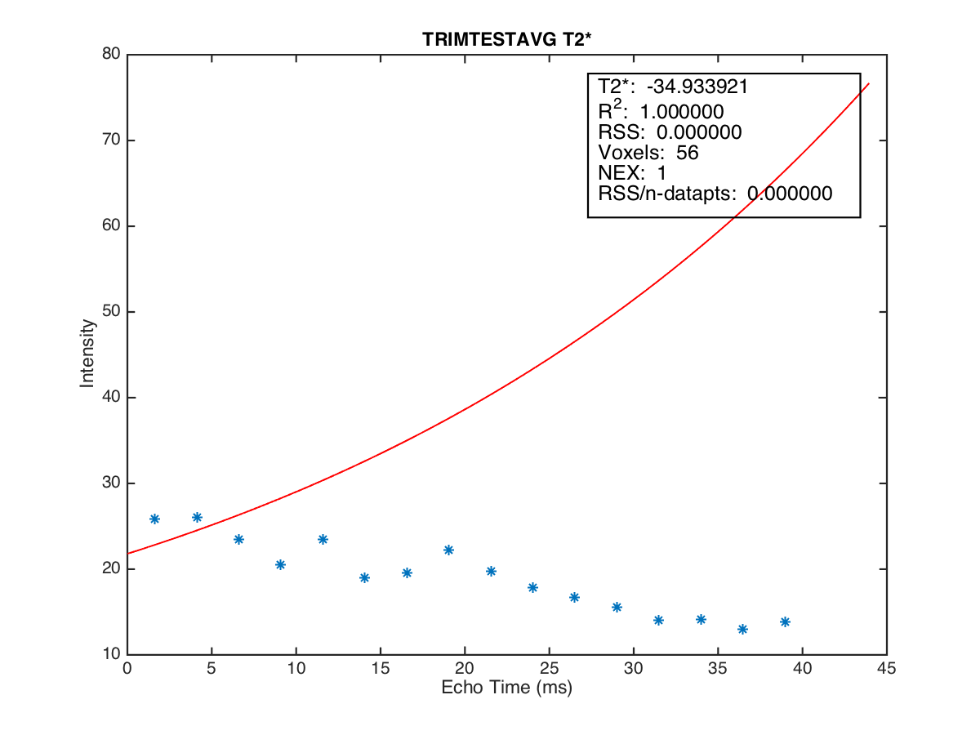
Improve Transfer Function
week 1 position 5

Slide 9
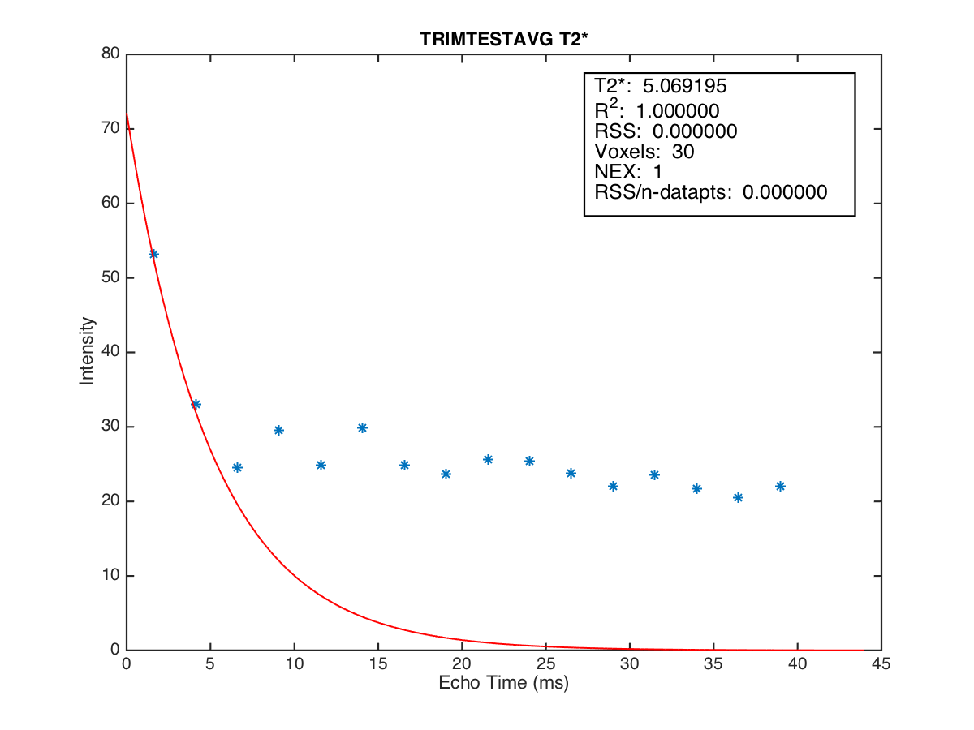
Improve Transfer Function
week 1 position 10

Slide 10
Improve Transfer Function
max
min
min
Ratio =
max

Slide 11
Improve Transfer Function
Ratio 1.5T
position | 1 | 2 | 3 | 4 | 5 | 6 | 7 | 8 | 9 | 10 | 11 | 12 | 13 | 14 | 15
week1 | 0.046 | 0.057 | 0.086 | 0.153 | 0.497 | 0.040 | 0.047 | 0.066 | 0.116 | 0.385 | 0.081 | 0.045 | 0.051 | 0.076 | 0.125
week2 | 0.048 | 0.056 | 0.070 | 0.163 | 0.615 | 0.040 | 0.050 | 0.062 | 0.142 | 0.473 | 0.082 | 0.044 | 0.054 | 0.066 | 0.118
week3 | 0.046 | 0.052 | 0.077 | 0.159 | 0.599 | 0.045 | 0.055 | 0.065 | 0.139 | 0.411 | 0.099 | 0.043 | 0.053 | 0.070 | 0.130
week4 | 0.044 | 0.053 | 0.071 | 0.138 | 0.656 | 0.052 | 0.053 | 0.064 | 0.128 | 0.479 | 0.086 | 0.040 | 0.048 | 0.059 | 0.124
week5 | 0.046 | 0.056 | 0.076 | 0.166 | 0.610 | 0.053 | 0.048 | 0.060 | 0.146 | 0.442 | 0.097 | 0.049 | 0.054 | 0.070 | 0.126
week6 | 0.049 | 0.052 | 0.071 | 0.178 | 0.670 | 0.052 | 0.047 | 0.065 | 0.123 | 0.441 | 0.086 | 0.040 | 0.055 | 0.061 | 0.136
week7 | 0.046 | 0.057 | 0.079 | 0.144 | 0.552 | 0.044 | 0.049 | 0.060 | 0.135 | 0.471 | 0.090 | 0.043 | 0.045 | 0.064 | 0.108
week8 | 0.046 | 0.053 | 0.076 | 0.150 | 0.523 | 0.047 | 0.059 | 0.066 | 0.132 | 0.347 | 0.102 | 0.043 | 0.048 | 0.061 | 0.110
week9 | 0.048 | 0.048 | 0.077 | 0.130 | 0.489 | 0.037 | 0.055 | 0.065 | 0.127 | 0.399 | 0.114 | 0.044 | 0.050 | 0.058 | 0.102
week10 | 0.051 | 0.056 | 0.077 | 0.128 | 0.522 | 0.054 | 0.046 | 0.069 | 0.122 | 0.333 | 0.112 | 0.045 | 0.051 | 0.067 | 0.102
week11 | 0.045 | 0.055 | 0.071 | 0.133 | 0.520 | 0.044 | 0.050 | 0.062 | 0.120 | 0.324 | 0.116 | 0.053 | 0.050 | 0.062 | 0.099
week12 | 0.047 | 0.055 | 0.077 | 0.132 | 0.511 | 0.061 | 0.049 | 0.060 | 0.115 | 0.312 | 0.111 | 0.046 | 0.051 | 0.056 | 0.103
week13 | 0.047 | 0.051 | 0.078 | 0.142 | 0.499 | 0.047 | 0.047 | 0.065 | 0.096 | 0.257 | 0.119 | 0.051 | 0.044 | 0.071 | 0.126
week14 | 0.047 | 0.046 | 0.075 | 0.149 | 0.626 | 0.040 | 0.054 | 0.063 | 0.115 | 0.338 | 0.096 | 0.046 | 0.045 | 0.062 | 0.119
week15 | 0.047 | 0.055 | 0.079 | 0.163 | 0.557 | 0.047 | 0.053 | 0.067 | 0.108 | 0.342 | 0.072 | 0.049 | 0.043 | 0.077 | 0.138
mean correct value | 0.047 | 0.053 | 0.076 | 0.148 | 0.563 | 0.047 | 0.051 | 0.064 | 0.124 | 0.384 | 0.098 | 0.045 | 0.049 | 0.065 | 0.118

Slide 12
Improve Transfer Function
Ratio 3T
position | 1 | 2 | 3 | 4 | 5 | 6 | 7 | 8 | 9 | 10 | 11 | 12 | 13 | 14 | 15
week1 | 0.061 | 0.085 | 0.131 | 0.225 | 0.363 | 0.065 | 0.097 | 0.093 | 0.188 | 0.505 | 0.126 | 0.065 | 0.058 | 0.104 | 0.185
week2 | 0.079 | 0.076 | 0.107 | 0.277 | 0.614 | 0.095 | 0.101 | 0.122 | 0.315 | 0.546 | 0.175 | 0.061 | 0.067 | 0.135 | 0.184
week3 | 0.064 | 0.082 | 0.080 | 0.256 | 0.673 | 0.099 | 0.083 | 0.131 | 0.226 | 0.563 | 0.170 | 0.060 | 0.051 | 0.116 | 0.205
week4 | 0.084 | 0.080 | 0.105 | 0.177 | 0.492 | 0.077 | 0.067 | 0.097 | 0.188 | 0.603 | 0.100 | 0.061 | 0.056 | 0.100 | 0.158
week5 | 0.065 | 0.087 | 0.084 | 0.356 | 0.705 | 0.088 | 0.086 | 0.129 | 0.266 | 0.534 | 0.101 | 0.052 | 0.065 | 0.110 | 0.182
week6 | 0.076 | 0.105 | 0.089 | 0.372 | 0.610 | 0.082 | 0.080 | 0.089 | 0.243 | 0.608 | 0.083 | 0.047 | 0.060 | 0.122 | 0.224
week7 | 0.062 | 0.089 | 0.097 | 0.274 | 0.492 | 0.103 | 0.065 | 0.116 | 0.177 | 0.523 | 0.098 | 0.053 | 0.053 | 0.089 | 0.188
week8 | 0.061 | 0.065 | 0.072 | 0.183 | 0.514 | 0.117 | 0.084 | 0.097 | 0.169 | 0.650 | 0.147 | 0.062 | 0.054 | 0.100 | 0.154
week9 | 0.111 | 0.072 | 0.096 | 0.233 | 0.564 | 0.110 | 0.067 | 0.090 | 0.159 | 0.417 | 0.113 | 0.053 | 0.049 | 0.081 | 0.139
week10 | 0.063 | 0.071 | 0.086 | 0.284 | 0.480 | 0.061 | 0.068 | 0.078 | 0.150 | 0.497 | 0.050 | 0.036 | 0.041 | 0.071 | 0.122
week11 | 0.070 | 0.072 | 0.079 | 0.178 | 0.591 | 0.073 | 0.074 | 0.097 | 0.120 | 0.505 | 0.050 | 0.044 | 0.040 | 0.069 | 0.071
week12 | 0.059 | 0.088 | 0.087 | 0.278 | 0.658 | 0.077 | 0.064 | 0.122 | 0.257 | 0.587 | 0.116 | 0.059 | 0.051 | 0.118 | 0.215
week13 | 0.064 | 0.069 | 0.085 | 0.256 | 0.589 | 0.078 | 0.069 | 0.077 | 0.199 | 0.574 | 0.125 | 0.049 | 0.065 | 0.102 | 0.180
week14 | 0.039 | 0.060 | 0.064 | 0.137 | 0.674 | 0.065 | 0.041 | 0.066 | 0.126 | 0.227 | 0.087 | 0.025 | 0.025 | 0.070 | 0.114
week15 | 0.067 | 0.096 | 0.097 | 0.313 | 0.670 | 0.084 | 0.074 | 0.088 | 0.185 | 0.515 | 0.098 | 0.068 | 0.061 | 0.102 | 0.221
mean correct value | 0.068 | 0.080 | 0.091 | 0.216 | 0.579 | 0.085 | 0.075 | 0.099 | 0.198 | 0.524 | 0.109 | 0.053 | 0.053 | 0.099 | 0.163

Slide 13
เพิ่มเงื่อนไขตรวจสอบค่า T2*
Improve Transfer Function
การตรวขสอบว่าค่า T2* ที่ได้ถูกต้องหรือไม่
1. ค่า ratio ต้องมีค่าต่ำกว่า 0.148 ใน 1.5T และ 0.216 ใน 3T
2. ค่า T2* ต้องไม่ติดลบ\
ถ้าไม่ถูกต้องจะกำหนดให้
ใน 1.5T ให้ค่า T2* มีค่าต่ำกว่า 1.205 โดยกำหนดให้มีค่าเท่ากับ 0.603 เพื่อง่ายแก่การ plot chart
ใน 3T ให้ค่า T2* มีค่าต่ำกว่า 1.084 โดยกำหนดให้มีค่าเท่ากับ 0.542 เพื่อง่ายแก่การ plot chart
 | 1.5T | 3T
ratio for check T2* | 0.148 | 0.216
min T2* | 1.205 | 1.084
T2* for plot | 0.6025 | 0.542

Slide 14
Result from CMRtools by user1
T2* from CMRtools by User 1
position | 1 | 2 | 3 | 4 | 5 | 6 | 7 | 8 | 9 | 10 | 11 | 12 | 13 | 14 | 15
week 1 | 7.472 | 3.863 | 2.106 | 13.252 | 54.442 | 8.986 | 4.294 | 2.392 | 1.694 | 47.031 | 14.164 | 7.833 | 4.083 | 2.179 | 2.202
week 2 | 7.600 | 3.924 | 1.962 | 19.144 | 92.331 | 9.660 | 4.532 | 2.327 | 1.761 | 64.817 | 14.758 | 7.588 | 4.013 | 2.217 | 2.752
week 3 | 7.990 | 3.995 | 2.065 | 18.610 | 80.747 | 10.199 | 4.758 | 2.389 | 1.698 | 54.687 | 15.151 | 7.947 | 4.169 | 2.285 | 2.797
week 4 | 7.756 | 3.956 | 2.114 | 17.785 | 99.775 | 10.260 | 4.678 | 2.357 | 1.626 | 69.011 | 14.628 | 7.843 | 4.102 | 2.305 | 2.368
week 5 | 7.709 | 3.958 | 2.227 | 18.545 | 90.826 | 9.989 | 4.624 | 2.392 | 1.668 | 64.196 | 14.947 | 7.920 | 4.147 | 2.451 | 2.432
week 6 | 7.647 | 3.868 | 2.117 | 20.311 | 98.065 | 9.831 | 4.612 | 2.409 | 1.571 | 72.217 | 14.534 | 7.559 | 3.871 | 2.311 | 2.719
week 7 | 8.026 | 4.097 | 2.199 | 15.745 | 83.790 | 10.178 | 4.766 | 2.452 | 1.644 | 69.057 | 15.180 | 8.228 | 4.256 | 2.423 | 2.100
week 8 | 8.454 | 4.394 | 2.429 | 14.747 | 84.559 | 10.509 | 4.866 | 2.508 | 1.712 | 49.386 | 16.385 | 8.732 | 4.485 | 2.573 | 2.105
week 9 | 8.534 | 4.438 | 2.435 | 11.795 | 87.890 | 10.267 | 4.986 | 2.554 | 1.610 | 55.730 | 16.388 | 8.838 | 4.604 | 2.613 | 1.972
week 10 | 8.121 | 4.153 | 2.225 | 11.757 | 82.637 | 10.175 | 4.812 | 2.458 | 1.476 | 46.617 | 14.798 | 8.079 | 4.242 | 2.318 | 1.923
week 11 | 7.981 | 4.045 | 2.176 | 2.666 | 78.897 | 10.079 | 4.633 | 2.425 | 1.445 | 40.703 | 14.817 | 7.998 | 4.204 | 2.336 | 1.947
week 12 | 8.149 | 4.171 | 2.225 | 11.896 | 81.419 | 10.265 | 4.733 | 2.428 | 1.513 | 38.037 | 15.244 | 8.158 | 4.296 | 2.327 | 1.926
week 13 | 7.868 | 4.138 | 2.243 | 11.954 | 60.037 | 10.408 | 4.777 | 2.632 | 1.562 | 28.215 | 15.068 | 8.067 | 4.259 | 2.373 | 2.084
week 14 | 7.971 | 4.184 | 2.291 | 16.887 | 106.901 | 10.568 | 4.988 | 2.658 | 1.661 | 41.032 | 15.331 | 8.203 | 4.303 | 2.535 | 2.312
week 15 | 7.419 | 3.859 | 2.161 | 19.119 | 90.140 | 10.167 | 4.657 | 2.571 | 1.483 | 49.621 | 14.011 | 7.409 | 3.847 | 2.297 | 2.596

Slide 15
Result from CMRtools by user2
T2* from CMRtools by User 2
position | 1 | 2 | 3 | 4 | 5 | 6 | 7 | 8 | 9 | 10 | 11 | 12 | 13 | 14 | 15
week 1 | 7.472 | 3.878 | 2.109 | 13.393 | 54.138 | 9.004 | 4.288 | 2.398 | 1.685 | 47.031 | 14.155 | 7.830 | 4.094 | 2.178 | 2.191
week 2 | 7.579 | 3.947 | 1.956 | 18.884 | 79.905 | 9.809 | 4.503 | 2.333 | 1.764 | 64.148 | 14.906 | 7.607 | 4.035 | 2.177 | 2.776
week 3 | 8.023 | 4.013 | 2.057 | 18.390 | 80.266 | 10.226 | 4.775 | 2.410 | 1.630 | 55.167 | 15.081 | 7.972 | 15.081 | 2.276 | 2.372
week 4 | 7.732 | 3.951 | 2.104 | 17.988 | 89.947 | 10.306 | 4.666 | 2.343 | 1.673 | 63.101 | 14.555 | 7.781 | 4.066 | 2.324 | 2.888
week 5 | 7.624 | 7.624 | 2.190 | 21.031 | 87.264 | 9.953 | 4.564 | 2.375 | 1.619 | 58.119 | 14.859 | 7.944 | 4.187 | 2.484 | 2.768
week 6 | 7.623 | 3.936 | 2.129 | 20.541 | 96.023 | 9.850 | 4.552 | 2.418 | 1.511 | 67.464 | 14.488 | 7.503 | 3.892 | 2.462 | 3.189
week 7 | 7.974 | 4.099 | 2.193 | 16.167 | 91.096 | 10.209 | 4.691 | 2.413 | 1.697 | 66.282 | 15.127 | 8.147 | 4.275 | 2.527 | 2.545
week 8 | 8.474 | 4.343 | 2.346 | 14.430 | 86.911 | 10.561 | 4.810 | 2.491 | 1.586 | 50.286 | 16.332 | 8.647 | 4.493 | 2.605 | 2.173
week 9 | 8.497 | 4.427 | 2.403 | 13.424 | 83.012 | 10.318 | 4.932 | 2.555 | 1.571 | 49.850 | 16.445 | 8.879 | 4.608 | 2.670 | 2.046
week 10 | 8.052 | 4.117 | 2.205 | 12.626 | 73.543 | 10.161 | 4.762 | 2.444 | 1.474 | 43.268 | 14.746 | 8.036 | 4.266 | 2.396 | 2.053
week 11 | 7.992 | 4.067 | 2.161 | 10.071 | 82.511 | 10.147 | 4.655 | 2.436 | 1.450 | 40.072 | 14.824 | 8.026 | 4.250 | 2.320 | 2.185
week 12 | 8.120 | 4.170 | 2.167 | 13.535 | 79.356 | 10.290 | 4.649 | 2.414 | 1.451 | 40.251 | 15.162 | 8.167 | 4.324 | 2.390 | 2.135
week 13 | 7.845 | 4.138 | 2.250 | 12.361 | 60.313 | 10.369 | 4.760 | 2.619 | 1.574 | 31.018 | 15.049 | 8.076 | 4.237 | 2.319 | 2.189
week 14 | 7.967 | 4.156 | 2.281 | 16.034 | 101.040 | 10.571 | 4.994 | 2.643 | 1.618 | 39.537 | 15.332 | 8.213 | 4.285 | 2.553 | 2.322
week 15 | 7.385 | 3.869 | 2.175 | 19.435 | 85.086 | 10.139 | 4.719 | 2.570 | 1.511 | 42.119 | 14.047 | 7.408 | 3.819 | 2.367 | 3.333

Slide 16
Result from CMRtools by user3
T2* from CMRtools by User 3
position | 1 | 2 | 3 | 4 | 5 | 6 | 7 | 8 | 9 | 10 | 11 | 12 | 13 | 14 | 15
week 1 | 7.553 | 3.865 | 2.089 | 12.476 | 52.136 | 9.004 | 4.293 | 2.378 | 1.671 | 50.799 | 14.167 | 7.853 | 4.065 | 2.203 | 2.196
week 2 | 7.584 | 3.948 | 1.950 | 20.564 | 88.360 | 9.617 | 4.520 | 2.312 | 1.757 | 67.834 | 14.776 | 7.653 | 4.050 | 2.275 | 2.720
week 3 | 8.035 | 4.001 | 2.069 | 19.959 | 70.486 | 10.210 | 4.774 | 2.405 | 1.615 | 55.991 | 15.230 | 7.996 | 4.215 | 2.293 | 3.082
week 4 | 7.812 | 3.969 | 2.156 | 20.228 | 97.954 | 10.260 | 4.666 | 2.357 | 1.696 | 77.482 | 14.668 | 7.868 | 4.156 | 2.328 | 2.580
week 5 | 7.720 | 3.935 | 2.241 | 19.656 | 118.885 | 9.934 | 4.594 | 2.382 | 11.968 | 72.101 | 14.971 | 7.970 | 4.158 | 2.477 | 2.303
week 6 | 7.657 | 3.930 | 2.153 | 21.789 | 92.996 | 9.774 | 4.562 | 2.408 | 1.567 | 73.798 | 14.605 | 7.602 | 3.886 | 2.384 | 2.610
week 7 | 8.036 | 4.142 | 2.195 | 15.911 | 87.089 | 10.149 | 4.760 | 2.434 | 1.744 | 74.778 | 15.312 | 8.239 | 4.287 | 2.487 | 2.098
week 8 | 8.459 | 4.376 | 2.451 | 14.873 | 80.090 | 10.509 | 4.855 | 2.491 | 1.695 | 52.986 | 16.415 | 8.755 | 4.522 | 2.633 | 2.099
week 9 | 8.555 | 4.459 | 2.462 | 12.406 | 83.582 | 10.292 | 5.032 | 2.563 | 1.588 | 55.746 | 16.417 | 8.931 | 4.614 | 2.635 | 1.803
week 10 | 8.067 | 4.139 | 2.227 | 12.987 | 78.409 | 10.142 | 4.813 | 2.437 | 1.487 | 51.644 | 14.873 | 8.071 | 4.228 | 2.401 | 1.898
week 11 | 8.014 | 4.061 | 2.191 | 10.685 | 82.368 | 10.052 | 4.630 | 2.410 | 1.430 | 45.439 | 14.863 | 8.015 | 4.259 | 2.416 | 1.810
week 12 | 8.152 | 4.169 | 2.156 | 14.270 | 84.618 | 10.247 | 4.703 | 2.410 | 1.428 | 40.962 | 15.286 | 8.196 | 4.333 | 2.428 | 1.908
week 13 | 7.864 | 4.153 | 2.272 | 13.941 | 55.887 | 10.340 | 4.743 | 2.611 | 1.547 | 28.804 | 15.135 | 8.073 | 4.263 | 2.485 | 2.102
week 14 | 8.047 | 4.198 | 2.232 | 13.747 | 83.003 | 10.739 | 5.065 | 2.657 | 1.606 | 32.090 | 15.200 | 8.227 | 4.292 | 2.501 | 2.124
week 15 | 7.404 | 3.893 | 2.165 | 17.494 | 85.415 | 10.068 | 4.667 | 2.569 | 1.529 | 51.521 | 14.117 | 7.480 | 3.895 | 2.292 | 2.598

Slide 17
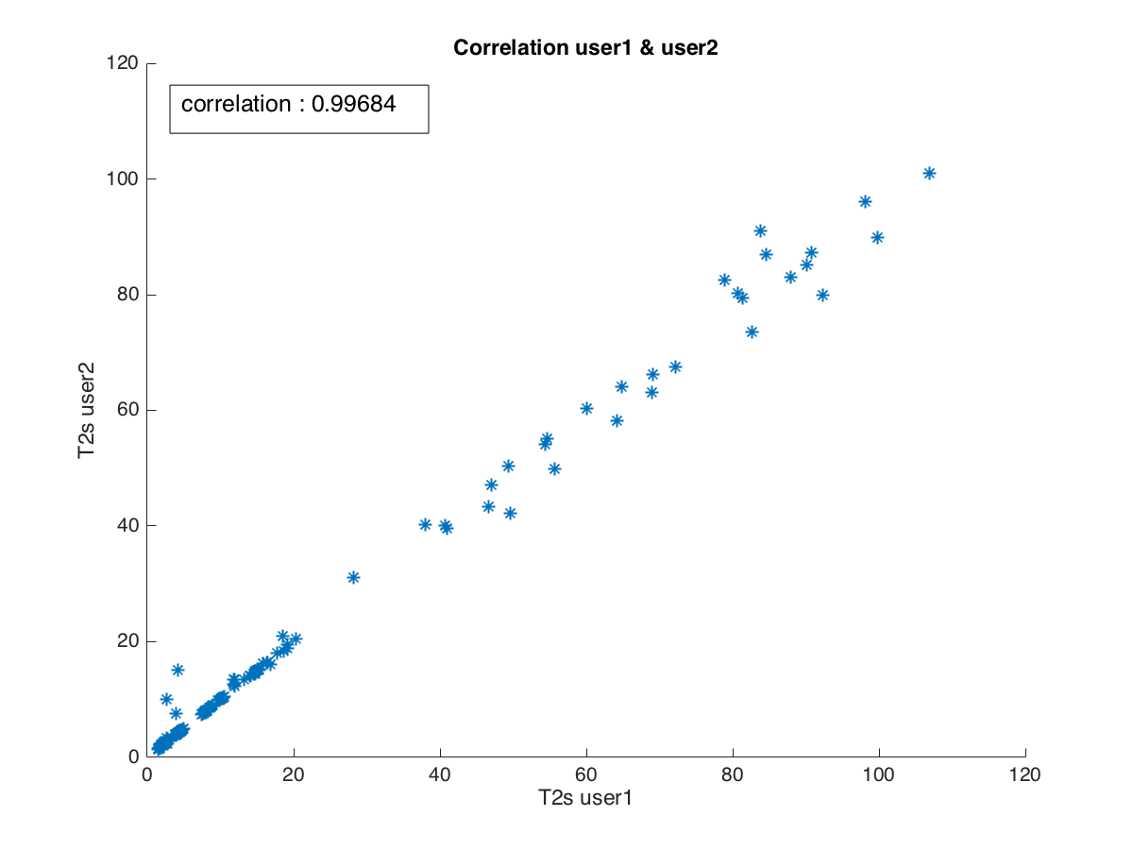
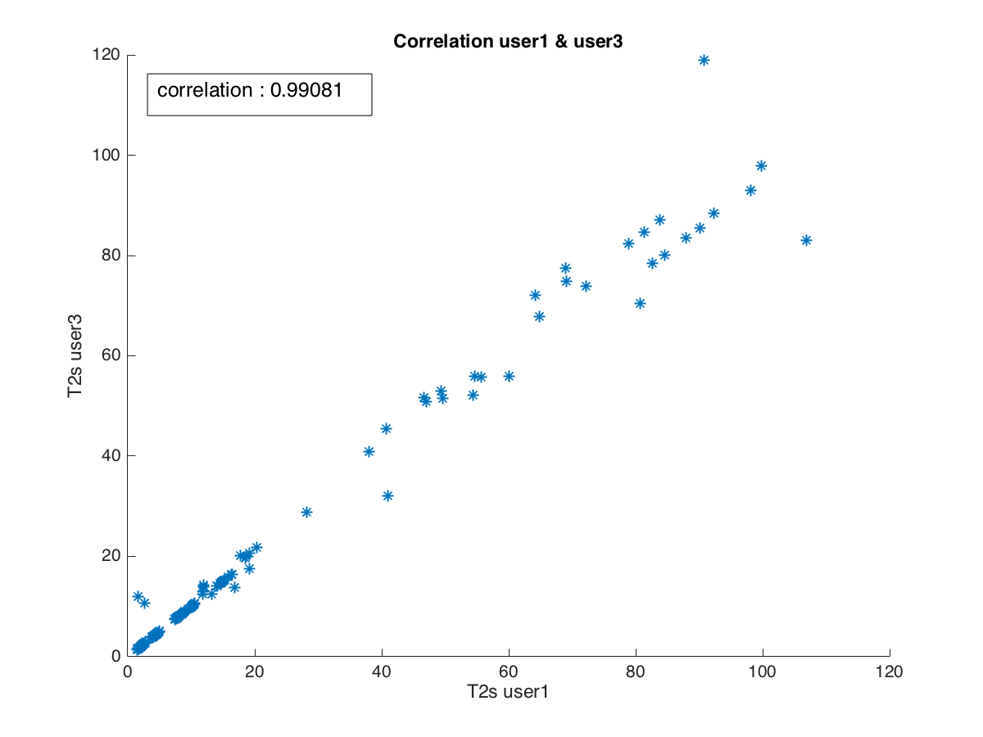
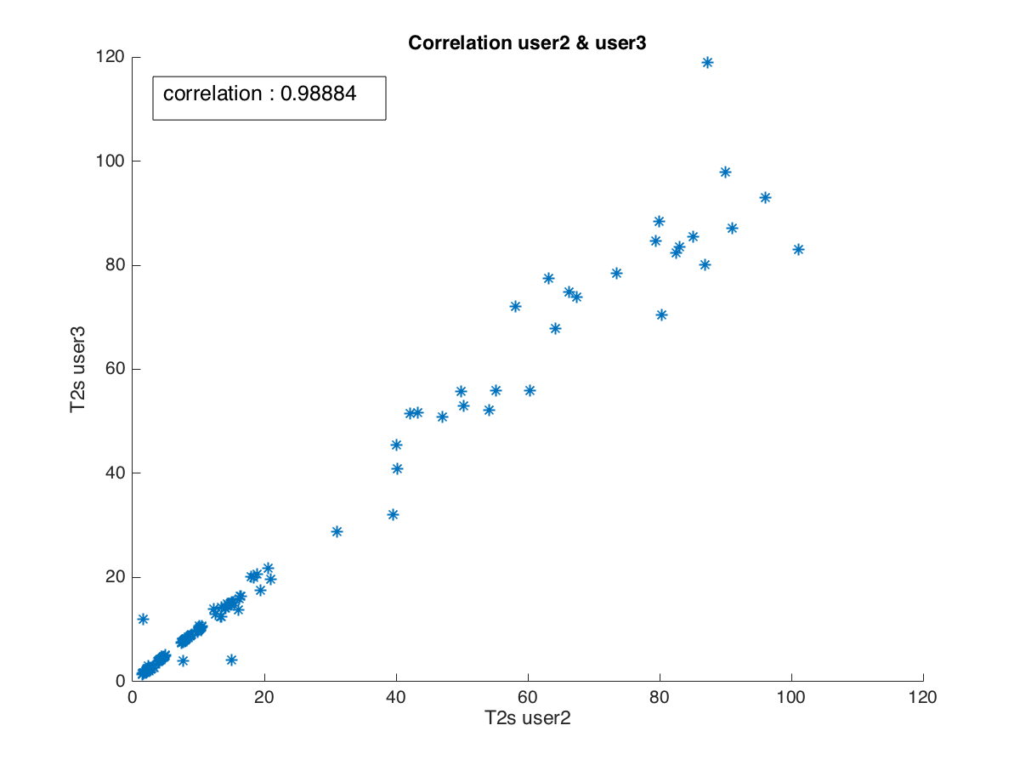
Correlation between user
Correlation |  | r | n
user1 | user2 | 0.9968 | 225
user1 | user3 | 0.9908 | 255
user2 | user3 | 0.9888 | 255

Slide 18
Result from MRIM 1.5T
T2* from MRIM by User 1
position | 1 | 2 | 3 | 4 | 5 | 6 | 7 | 8 | 9 | 10 | 11 | 12 | 13 | 14 | 15
week 1 | 7.183 | 3.613 | 2.006 | 0.603 | 0.603 | 8.891 | 4.231 | 2.232 | 1.238 | 0.603 | 13.985 | 7.423 | 3.622 | 1.921 | 1.535
week 2 | 7.470 | 3.642 | 1.942 | 0.603 | 0.603 | 9.490 | 4.365 | 2.198 | 1.302 | 0.603 | 14.509 | 7.163 | 3.781 | 2.418 | 1.591
week 3 | 7.632 | 3.675 | 1.804 | 0.603 | 0.603 | 9.917 | 4.551 | 2.312 | 1.181 | 0.603 | 14.971 | 7.725 | 3.907 | 2.331 | 1.642
week 4 | 7.504 | 3.673 | 2.087 | 1.520 | 0.603 | 9.956 | 4.496 | 2.255 | 1.140 | 0.603 | 14.199 | 7.394 | 3.982 | 2.382 | 1.495
week 5 | 7.557 | 3.641 | 1.926 | 0.603 | 0.603 | 9.745 | 4.395 | 2.284 | 1.233 | 0.603 | 14.633 | 7.637 | 3.754 | 2.440 | 1.558
week 6 | 7.444 | 3.627 | 2.046 | 0.603 | 0.603 | 9.486 | 4.476 | 2.268 | 1.116 | 0.603 | 14.330 | 7.323 | 3.595 | 2.426 | 1.604
week 7 | 7.829 | 3.871 | 1.985 | 1.538 | 0.603 | 9.998 | 4.460 | 2.246 | 1.192 | 0.603 | 14.872 | 7.960 | 3.993 | 2.450 | 1.454
week 8 | 8.152 | 4.243 | 2.131 | 0.603 | 0.603 | 10.184 | 4.571 | 2.257 | 1.241 | 0.603 | 15.814 | 8.277 | 4.197 | 2.432 | 1.503
week 9 | 8.382 | 4.166 | 2.177 | 1.537 | 0.603 | 10.204 | 4.694 | 2.415 | 1.204 | 0.603 | 15.846 | 8.510 | 4.179 | 2.426 | 1.429
week 10 | 8.009 | 3.855 | 1.927 | 1.334 | 0.603 | 9.979 | 4.692 | 2.259 | 1.165 | 0.603 | 14.631 | 7.753 | 4.030 | 2.215 | 1.347
week 11 | 7.785 | 3.774 | 1.964 | 1.352 | 0.603 | 9.841 | 4.406 | 2.402 | 1.139 | 0.603 | 14.148 | 7.671 | 3.993 | 2.390 | 1.409
week 12 | 7.944 | 3.928 | 1.991 | 1.330 | 0.603 | 9.941 | 4.502 | 2.351 | 1.171 | 0.603 | 14.927 | 7.883 | 4.101 | 2.225 | 1.420
week 13 | 7.755 | 3.858 | 2.112 | 1.305 | 0.603 | 10.208 | 4.574 | 2.585 | 1.260 | 0.603 | 14.822 | 7.655 | 3.988 | 2.380 | 1.514
week 14 | 7.840 | 3.950 | 2.091 | 0.603 | 0.603 | 10.373 | 4.824 | 2.518 | 1.308 | 0.603 | 15.019 | 7.996 | 4.012 | 2.496 | 1.562
week 15 | 7.251 | 3.623 | 2.061 | 0.603 | 0.603 | 9.888 | 4.415 | 2.315 | 1.183 | 0.603 | 13.808 | 7.090 | 3.561 | 2.390 | 1.642

Slide 19
Result from MRIM 3T
T2* from MRIM by User 1
position | 1 | 2 | 3 | 4 | 5 | 6 | 7 | 8 | 9 | 10 | 11 | 12 | 13 | 14 | 15
week 1 | 7.248 | 3.577 | 2.067 | 0.603 | 0.603 | 9.022 | 4.238 | 2.212 | 1.243 | 0.603 | 13.909 | 7.620 | 3.694 | 1.877 | 1.501
week 2 | 7.308 | 3.612 | 1.921 | 0.603 | 0.603 | 9.349 | 4.238 | 2.171 | 0.603 | 0.603 | 14.553 | 7.181 | 3.787 | 2.440 | 1.544
week 3 | 7.592 | 3.654 | 1.782 | 0.603 | 0.603 | 10.083 | 4.578 | 2.293 | 1.175 | 0.603 | 15.033 | 7.775 | 3.792 | 2.320 | 1.581
week 4 | 7.427 | 3.663 | 2.107 | 1.608 | 0.603 | 9.949 | 4.459 | 2.192 | 1.140 | 0.603 | 14.384 | 7.503 | 3.926 | 2.280 | 1.542
week 5 | 7.522 | 3.621 | 1.898 | 0.603 | 0.603 | 9.725 | 4.319 | 2.226 | 0.603 | 0.603 | 14.710 | 7.838 | 3.858 | 2.386 | 1.510
week 6 | 7.420 | 3.709 | 1.971 | 0.603 | 0.603 | 9.512 | 4.334 | 2.243 | 1.277 | 0.603 | 14.561 | 7.336 | 3.573 | 2.410 | 1.584
week 7 | 7.800 | 3.929 | 1.974 | 1.609 | 0.603 | 10.272 | 4.676 | 2.228 | 1.304 | 0.603 | 15.279 | 8.063 | 3.892 | 2.266 | 1.448
week 8 | 8.176 | 4.410 | 2.304 | 0.603 | 0.603 | 10.377 | 4.514 | 2.225 | 1.312 | 0.603 | 16.048 | 8.387 | 4.298 | 2.341 | 1.477
week 9 | 8.329 | 4.255 | 2.283 | 1.493 | 0.603 | 9.991 | 4.862 | 2.423 | 1.217 | 0.603 | 16.091 | 8.655 | 4.232 | 2.367 | 1.354
week 10 | 7.949 | 4.025 | 2.108 | 1.353 | 0.603 | 10.003 | 4.663 | 2.207 | 1.152 | 0.603 | 14.758 | 7.731 | 4.034 | 2.237 | 1.278
week 11 | 7.750 | 3.817 | 2.142 | 1.418 | 0.603 | 9.881 | 4.464 | 2.353 | 1.139 | 0.603 | 14.418 | 7.663 | 3.939 | 2.300 | 1.277
week 12 | 7.931 | 3.946 | 2.008 | 1.303 | 0.603 | 10.244 | 4.403 | 2.307 | 1.184 | 0.603 | 15.017 | 7.877 | 4.243 | 2.206 | 1.365
week 13 | 7.693 | 3.903 | 2.181 | 0.603 | 0.603 | 10.172 | 4.509 | 2.644 | 1.289 | 0.603 | 14.964 | 7.724 | 3.958 | 2.196 | 1.471
week 14 | 7.840 | 3.935 | 2.120 | 1.741 | 0.603 | 10.443 | 4.805 | 2.455 | 1.391 | 0.603 | 14.945 | 8.168 | 4.094 | 2.443 | 1.518
week 15 | 7.039 | 3.684 | 2.135 | 0.603 | 0.603 | 9.676 | 4.627 | 2.407 | 1.267 | 0.603 | 14.065 | 7.118 | 3.594 | 2.385 | 1.553

Slide 20
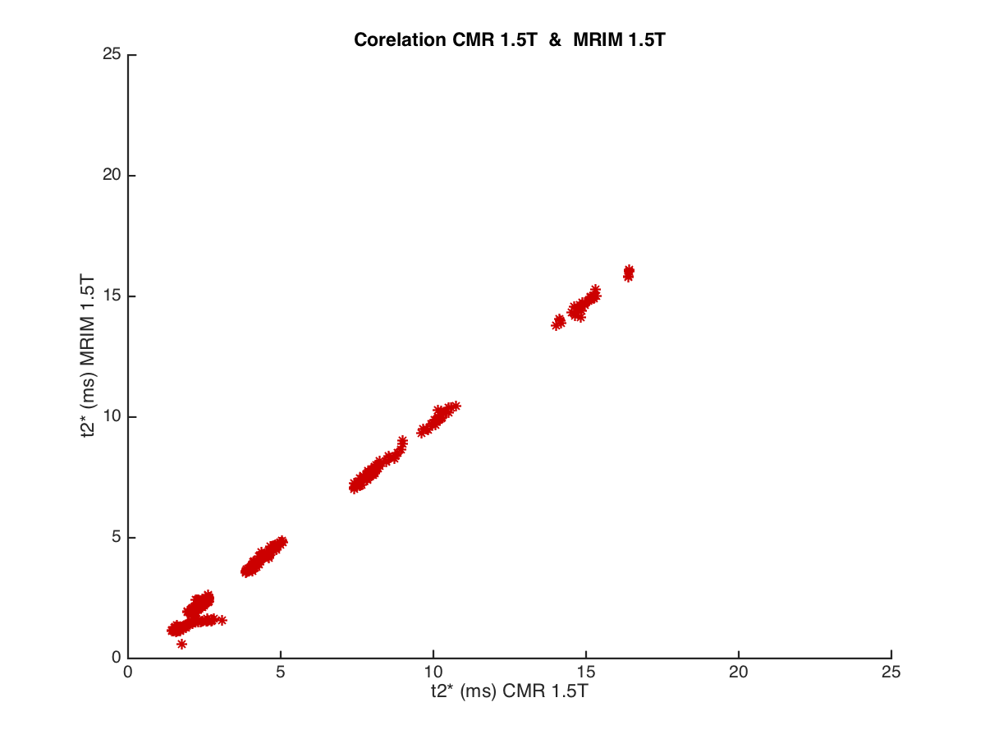
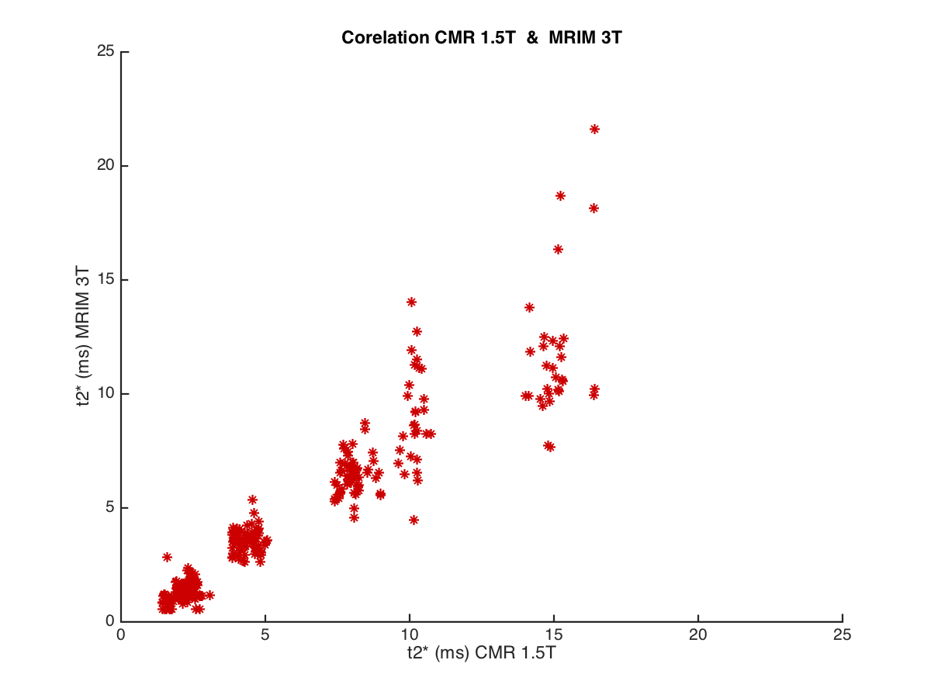
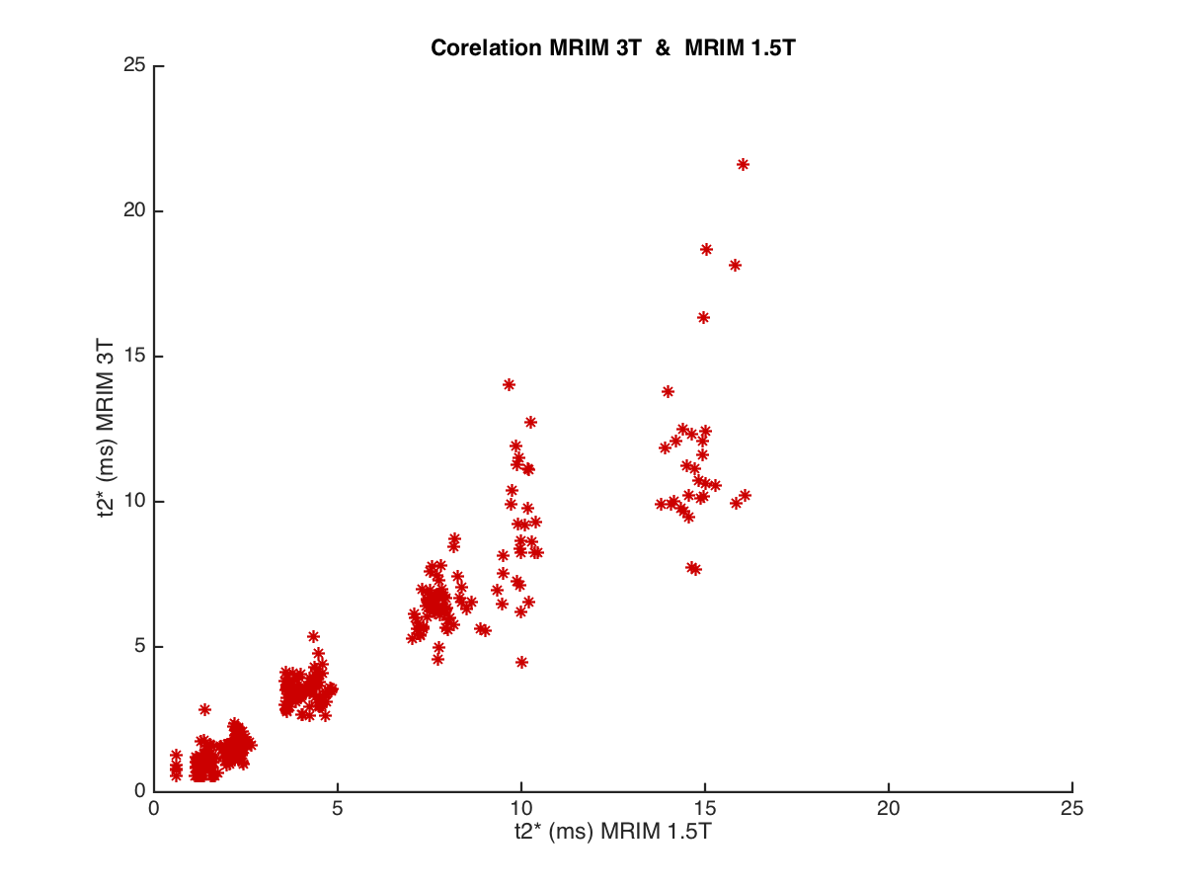
Correlation between program
Except position 4,5,10
Except position 4,5,10
T2* input | T2* output | m | c
CMRtools | MRIM1.5T | 0.999 | 179
CMRtools | MRIM 3T | 0.942 | 179
MRIM1.5T | MRIM 3T | 0.9523 | 225
All position

Slide 21


Mapping Function
T2*output = m x T2*input + c
T2* input | T2* output | m | c
CMRtools | MRIM 1.5T | 1.004 | -0.299
MRIM 1.5T | MRIM 13T | 0.833 | -0.047
MRIM1.5T = 1 x CMRtools + (-0.3)
MRIM3T = 0.83 x MRIM1.5T + (-0.05)

Slide 22
Guidelines for Iron Assessment
Myocardial loading | Myocardial T2* |  | Hepatic loading | Hepatic T2* (ms) | Dry weight
None | > 20 ms |  | None | > 6.3 ms | < 2 mg/g
Mild | >14-20 ms |  | Mild | >2.7-6.3 ms | 2- 5 mg/g
Moderate | 10-14 ms |  | Moderate | 1.4-2.7 ms | >5-10 mg/g
Severe* | < 10 ms |  | Severe | < 1.4 ms | > 10 mg/g
CMRtools
Myocardial loading | Myocardial T2* (New Calculate) |  | Hepatic loading | Hepatic T2* (ms) (New Calculate) | Dry weight
None | > 19.79 ms |  | None | > 6.03 ms | < 2 mg/g
Mild | >13.76-19.79 ms |  | Mild | >2.41-6.03 ms | 2- 5 mg/g
Moderate | 9.74-13.76 ms |  | Moderate | 1.11-2.41 ms | >5-10 mg/g
Severe* | < 9.74 ms |  | Severe | < 1.11 ms | > 10 mg/g
MRIM 1.5T
Myocardial loading | Myocardial T2* (New Calculate) |  | Hepatic loading | Hepatic T2* (ms) (New Calculate) | Dry weight
None | > 16.43 ms |  | None | > 4.97 ms | < 2 mg/g
Mild | >11.41-16.43 ms |  | Mild | >1.96-4.97 ms | 2- 5 mg/g
Moderate | 8.07-11.41 ms |  | Moderate | 0.87-1.96 ms | >5-10 mg/g
Severe* | < 8.07 ms |  | Severe | < 0.87 ms | > 10 mg/g
MRIM 3T

Slide 23
Result in 1st week
CMRtools
p | user1 | user2 | user3 | mean
1 | 7.472 | 7.472 | 7.553 | 7.499
2 | 3.863 | 3.878 | 3.865 | 3.869
3 | 2.106 | 2.109 | 2.089 | 2.101
4 | 13.252 | 13.393 | 12.476 | 13.040
5 | 54.442 | 54.138 | 52.136 | 53.572
6 | 8.986 | 9.004 | 9.004 | 8.998
7 | 4.294 | 4.288 | 4.293 | 4.292
8 | 2.392 | 2.398 | 2.378 | 2.389
9 | 1.694 | 1.685 | 1.671 | 1.683
10 | 47.031 | 47.031 | 50.799 | 48.287
11 | 14.164 | 14.155 | 14.167 | 14.162
12 | 7.833 | 7.830 | 7.853 | 7.839
13 | 4.083 | 4.094 | 4.065 | 4.081
14 | 2.179 | 2.178 | 2.203 | 2.187
15 | 2.202 | 2.191 | 2.196 | 2.196
MRIM 1.5T
p | user1 | user2 | user3 | mean
1 | 7.183 | 7.171 | 7.248 | 7.201
2 | 3.613 | 3.674 | 3.577 | 3.622
3 | 2.006 | 2.025 | 2.067 | 2.033
4 | 0.603 | 0.603 | 0.603 | 0.603
5 | 0.603 | 0.603 | 0.603 | 0.603
6 | 8.891 | 8.963 | 9.022 | 8.958
7 | 4.231 | 4.211 | 4.238 | 4.226
8 | 2.232 | 2.249 | 2.212 | 2.231
9 | 1.238 | 1.211 | 1.243 | 1.231
10 | 0.603 | 0.603 | 0.603 | 0.603
11 | 13.985 | 13.975 | 13.909 | 13.957
12 | 7.423 | 7.481 | 7.620 | 7.508
13 | 3.622 | 3.607 | 3.694 | 3.641
14 | 1.921 | 1.922 | 1.877 | 1.907
15 | 1.535 | 1.554 | 1.501 | 1.530
MRIM 3T
p | user1 | user2 | user3 | mean
1 | 5.460 | 5.423 | 5.416 | 5.433
2 | 2.820 | 2.853 | 2.839 | 2.837
3 | 1.650 | 1.639 | 1.635 | 1.641
4 | 0.542 | 0.542 | 1.256 | 0.780
5 | 0.542 | 0.542 | 0.542 | 0.542
6 | 5.635 | 5.624 | 5.547 | 5.602
7 | 2.940 | 2.663 | 2.643 | 2.749
8 | 2.125 | 2.086 | 2.157 | 2.123
9 | 1.021 | 1.208 | 0.965 | 1.065
10 | 0.542 | 0.542 | 0.542 | 0.542
11 | 13.775 | 13.870 | 11.869 | 13.171
12 | 6.021 | 5.987 | 6.223 | 6.077
13 | 2.777 | 2.837 | 2.931 | 2.848
14 | 1.605 | 1.556 | 1.463 | 1.541
15 | 1.170 | 1.140 | 1.145 | 1.152

Slide 24
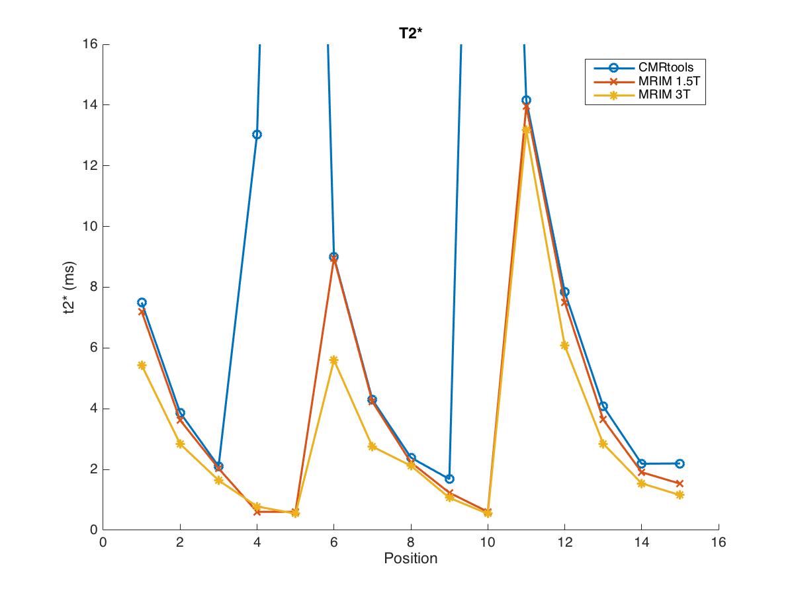
Result in 1st week
p | CMRtools | 1.5T | 3T | Conc.
1 | 7.499 | 7.201 | 5.433 | 0.505
2 | 3.869 | 3.622 | 2.837 | 0.789
3 | 2.101 | 2.033 | 1.641 | 1.413
4 | 13.040 | 0.603 | 0.780 | 2.470
5 | 53.572 | 0.603 | 0.542 | 5.059
6 | 8.998 | 8.958 | 5.602 | 0.871
7 | 4.292 | 4.226 | 2.749 | 1.761
8 | 2.389 | 2.231 | 2.123 | 3.584
9 | 1.683 | 1.231 | 1.065 | 6.387
10 | 48.287 | 0.603 | 0.542 | 12.421
11 | 14.162 | 13.957 | 13.171 | 1.060
12 | 7.839 | 7.508 | 6.077 | 1.682
13 | 4.081 | 3.641 | 2.848 | 3.375
14 | 2.187 | 1.907 | 1.541 | 6.956
15 | 2.196 | 1.530 | 1.152 | 9.698

Slide 25
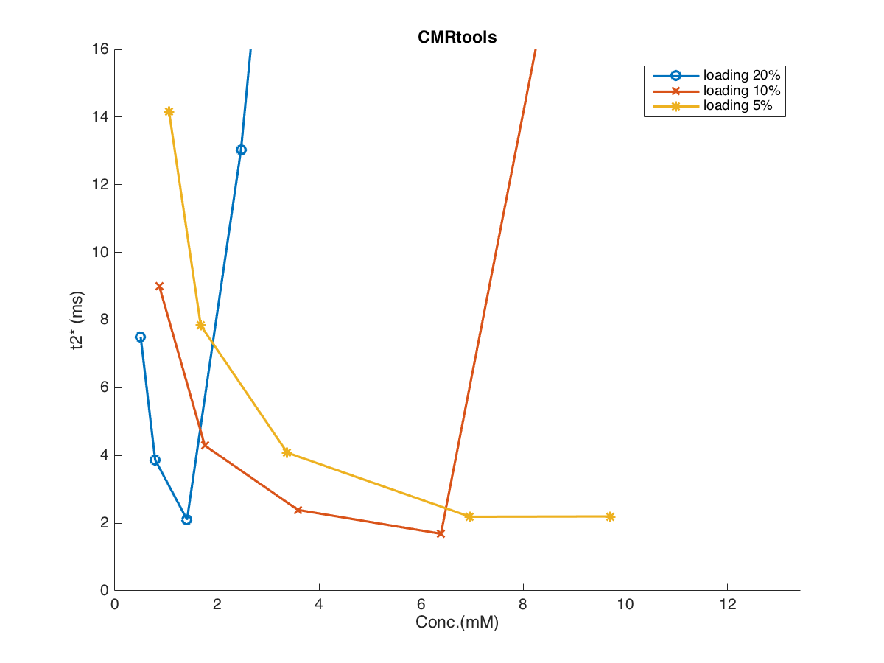


p | CMRtools | Conc.
1 | 7.499 | 0.505
2 | 3.869 | 0.789
3 | 2.101 | 1.413
4 | 13.040 | 2.470
5 | 53.572 | 5.059
6 | 8.998 | 0.871
7 | 4.292 | 1.761
8 | 2.389 | 3.584
9 | 1.683 | 6.387
10 | 48.287 | 12.421
11 | 14.162 | 1.060
12 | 7.839 | 1.682
13 | 4.081 | 3.375
14 | 2.187 | 6.956
15 | 2.196 | 9.698
p | CMRtools | 1.5T | 3T | Conc.
1 | 7.499 | 7.201 | 5.433 | 0.505
2 | 3.869 | 3.622 | 2.837 | 0.789
3 | 2.101 | 2.033 | 1.641 | 1.413
4 | 13.040 | 0.603 | 0.780 | 2.470
5 | 53.572 | 0.603 | 0.542 | 5.059
6 | 8.998 | 8.958 | 5.602 | 0.871
7 | 4.292 | 4.226 | 2.749 | 1.761
8 | 2.389 | 2.231 | 2.123 | 3.584
9 | 1.683 | 1.231 | 1.065 | 6.387
10 | 48.287 | 0.603 | 0.542 | 12.421
11 | 14.162 | 13.957 | 13.171 | 1.060
12 | 7.839 | 7.508 | 6.077 | 1.682
13 | 4.081 | 3.641 | 2.848 | 3.375
14 | 2.187 | 1.907 | 1.541 | 6.956
15 | 2.196 | 1.530 | 1.152 | 9.698

Slide 26
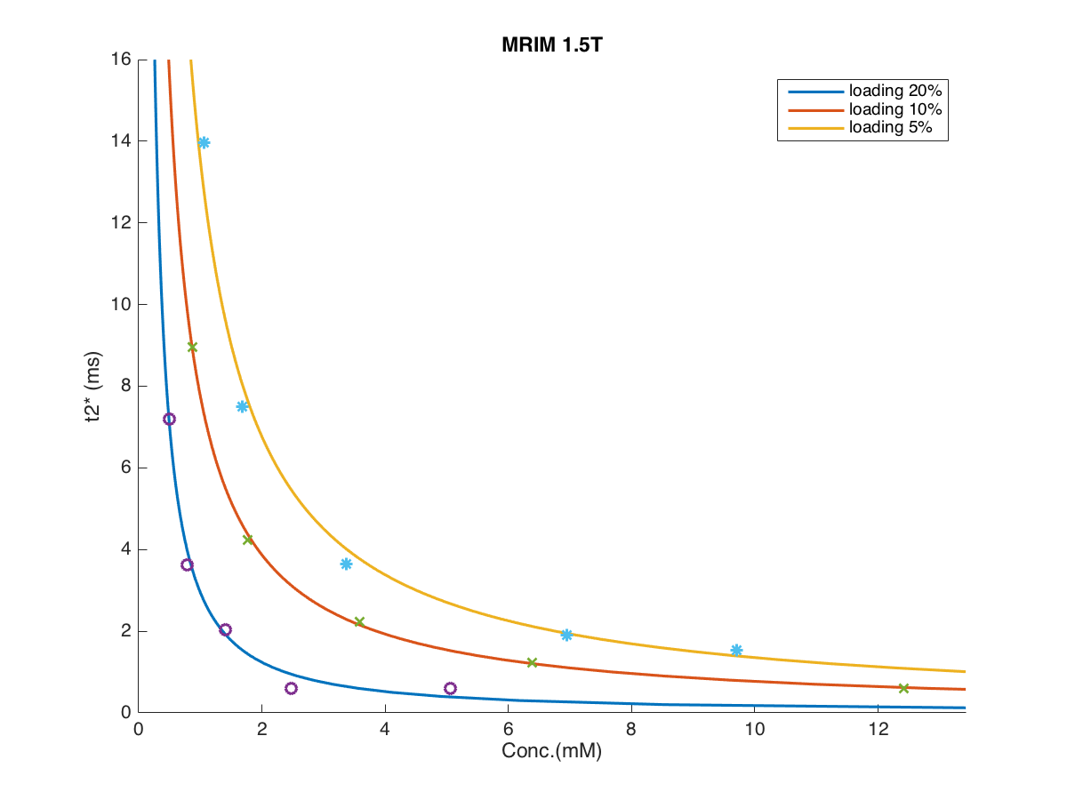
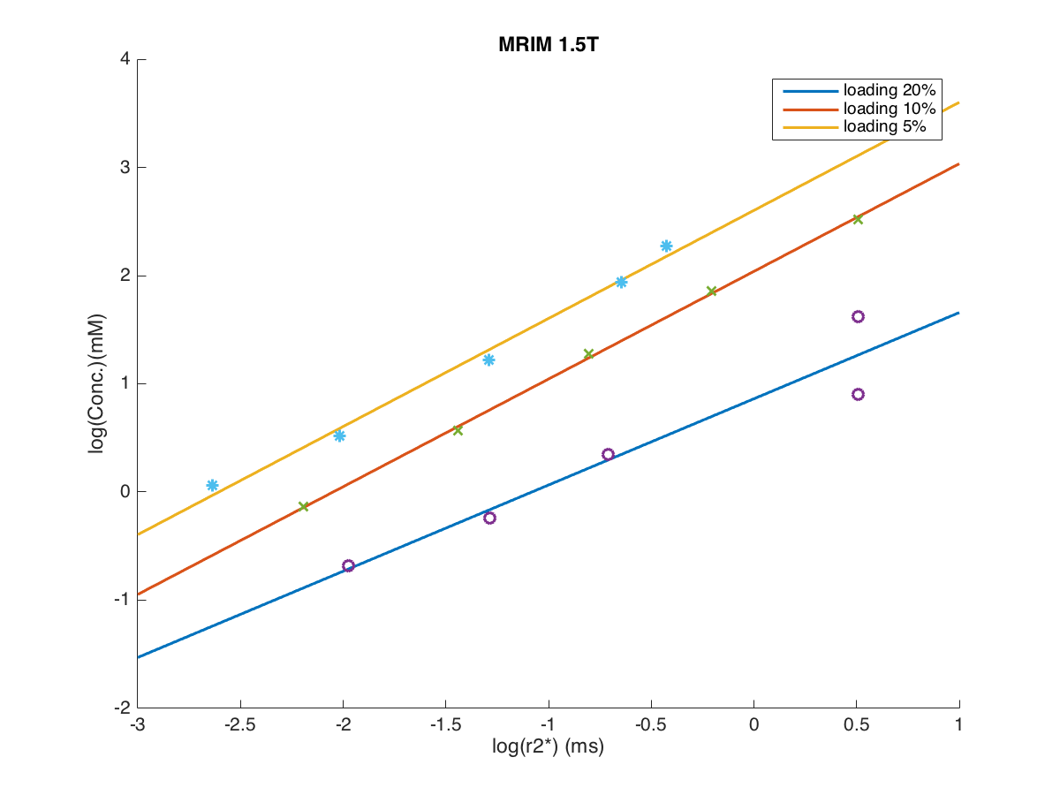
MRIM 1.5T
(c - m*log(T2s))
p | 1.5T | Conc.
1 | 7.201 | 0.505
2 | 3.622 | 0.789
3 | 2.033 | 1.413
4 | 0.603 | 2.470
5 | 0.603 | 5.059
6 | 8.958 | 0.871
7 | 4.226 | 1.761
8 | 2.231 | 3.584
9 | 1.231 | 6.387
10 | 0.603 | 12.421
11 | 13.957 | 1.060
12 | 7.508 | 1.682
13 | 3.641 | 3.375
14 | 1.907 | 6.956
15 | 1.530 | 9.698
Conc. = e
loading | m | c
20% | 0.797 | 0.861
10% | 0.995 | 2.039
5% | 0.999 | 2.603

Slide 27
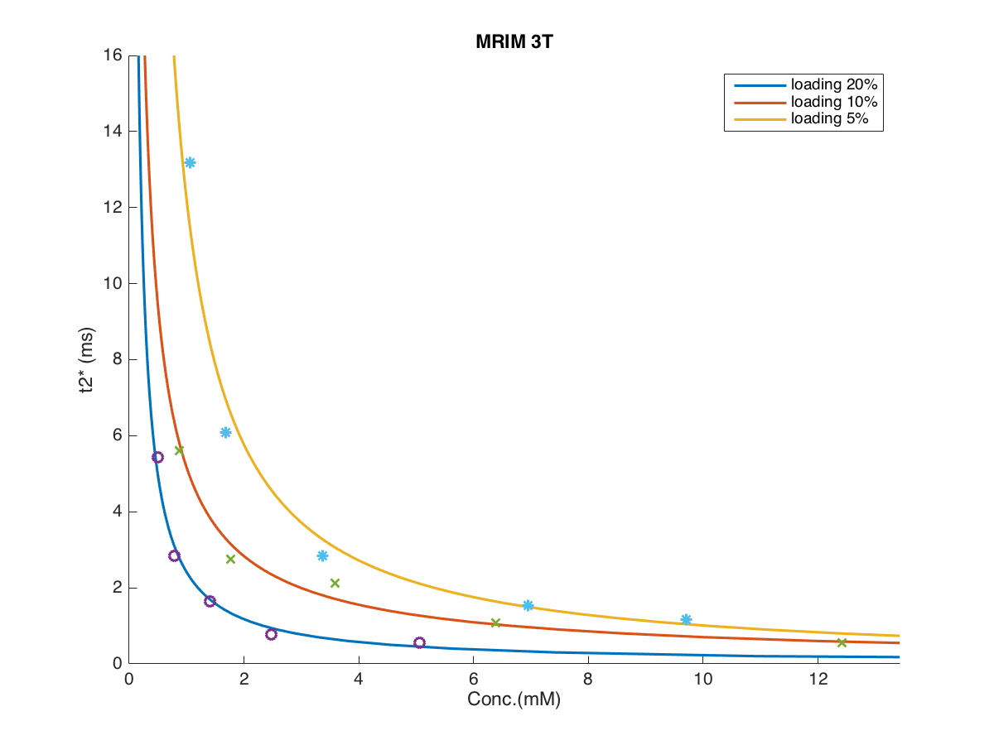
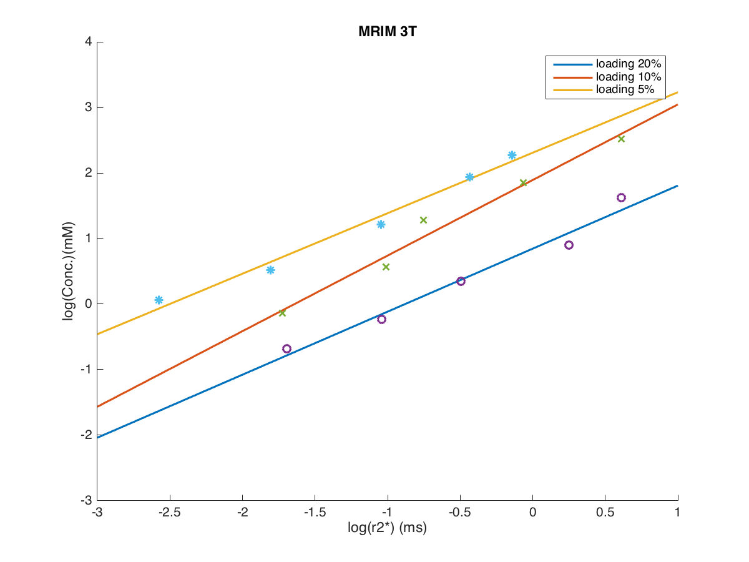
MRIM 3T
(c - m*log(T2s))
p | 3T | Conc.
1 | 5.433 | 0.505
2 | 2.837 | 0.789
3 | 1.641 | 1.413
4 | 0.780 | 2.470
5 | 0.542 | 5.059
6 | 5.602 | 0.871
7 | 2.749 | 1.761
8 | 2.123 | 3.584
9 | 1.065 | 6.387
10 | 0.542 | 12.421
11 | 13.171 | 1.060
12 | 6.077 | 1.682
13 | 2.848 | 3.375
14 | 1.541 | 6.956
15 | 1.152 | 9.698
Conc. = e
loading | a | b
20% | 0.961 | 0.846
10% | 1.153 | 1.893
5% | 0.923 | 2.309

Slide 28
T2* |  | Dry Weight
mapping |  | CMRtools | MRIM 1.5T
CMRtools | MRIM1.5T |  | load 20% | load 10% | load 5%
6.300 | 6.026 | 2.000 | 0.546 | 1.230 | 2.147
2.700 | 2.412 | 5.000 | 1.072 | 2.859 | 5.006
1.400 | 1.107 | 10.000 | 1.810 | 5.497 | 9.648
T2* |  | Dry Weight
mapping |  | CMRtools | MRIM 3T
MRIM1.5T | MRIM3T |  | load 20% | load 10% | load 5%
6.026 | 4.973 | 2.000 | 0.498 | 1.044 | 2.291
2.412 | 1.962 | 5.000 | 1.219 | 3.052 | 5.405
1.107 | 0.875 | 10.000 | 2.649 | 7.744 | 11.390

Slide 29
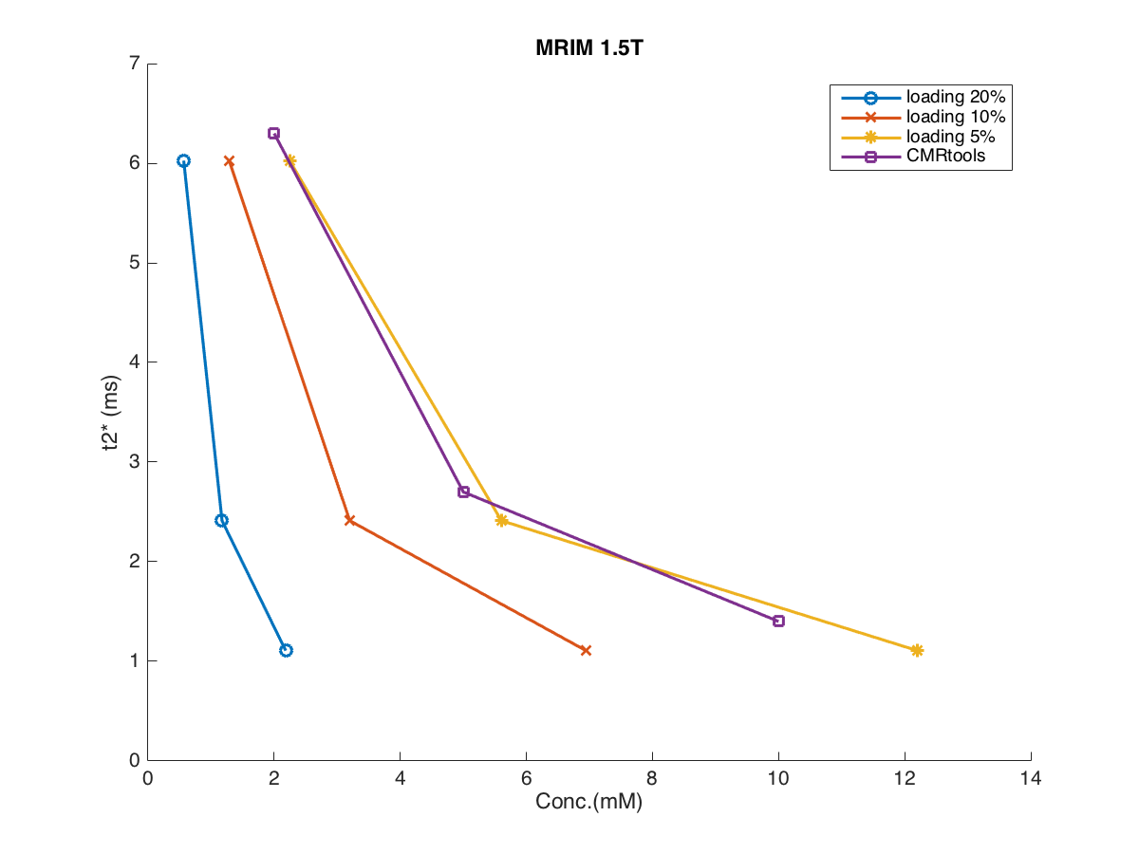

Guidelines for Iron Assessment
MRIM 1.5T
None
Mild
Moderate
Severe
Hepatic loading | Hepatic T2* (ms) (CMRtools) | Dry weight CMR |  | Hepatic T2* (ms) (New Calculate) | Dry weight 20% | Dry weight 10% | Dry weight 5%
None | > 6.3 ms | < 2 mg/g |  | > 6.03 ms | < 0.57 mM | < 1.23 mM | < 2.14 mM
Mild | >2.7-6.3 ms | 2- 5 mg/g |  | >2.41-6.03 ms | 0.57- 1.07 mM | 1.23- 2.86 mM | 2.14- 5.01 mM
Moderate | 1.4-2.7 ms | >5-10 mg/g |  | 1.11-2.41 ms | >1.07-1.81 mM | >2.86-5.50 mM | >5.01-9.65 mM
Severe | < 1.4 ms | > 10 mg/g |  | < 1.11 ms | > 1.81 mM | > 5.50 mM | > 9.65 mM

Slide 30
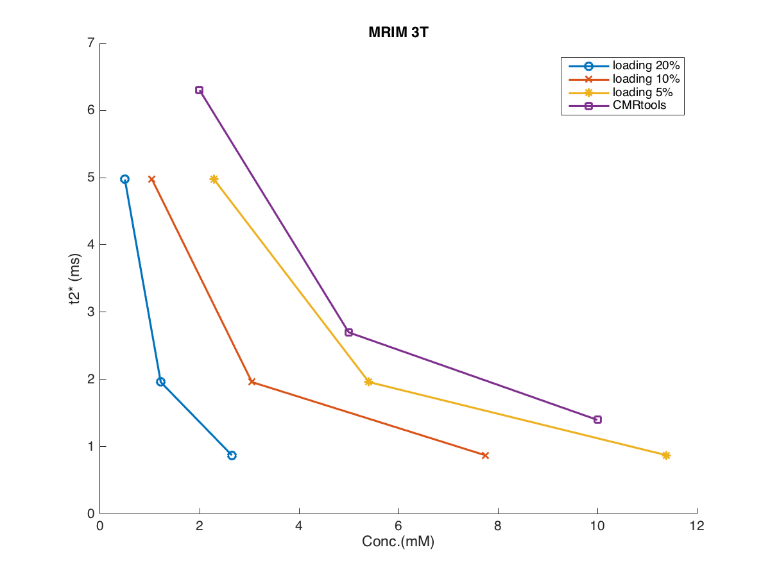
Guidelines for Iron Assessment
MRIM 3T
None
Mild
Moderate
Severe
Hepatic loading | Hepatic T2* (ms) (CMRtools) | Dry weight CMR |  | Hepatic T2* (ms) (New Calculate) | Dry weight 20% | Dry weight 10% | Dry weight 5%
None | > 6.3 ms | < 2 mg/g |  | > 6.03 ms | < 0.50 mM | < 1.04 mM | < 2.3 mM
Mild | >2.7-6.3 ms | 2- 5 mg/g |  | >2.41-6.03 ms | 0.50- 1.22 mM | 1.04- 3.05 mM | 2.3- 5.41 mM
Moderate | 1.4-2.7 ms | >5-10 mg/g |  | 1.11-2.41 ms | > 1.22-2.65 mM | >3.05-7.74 mM | > 5.41-11.39mM
Severe | < 1.4 ms | > 10 mg/g |  | < 1.11 ms | > 2.65 mM | > 7.74 mM | > 11.39 mM

Slide 31
Normalisation T2*
norm T2* = ( T2* - Initial T2* ) x Initial T2*
Normalisation T2*
 | week1 | week2 | week3 | week4 | week5 | week6 | week7 | week8 | week9 | week10 | week11 | week12 | week13 | week14 | week15
position1 | -0.01 | 0.01 | 0.04 | 0.02 | 0.03 | 0.02 | 0.07 | 0.12 | 0.14 | 0.09 | 0.06 | 0.09 | 0.06 | 0.07 | -0.02
position2 | -0.00 | 0.00 | 0.01 | 0.02 | 0.01 | 0.02 | 0.08 | 0.20 | 0.17 | 0.09 | 0.05 | 0.09 | 0.07 | 0.09 | 0.01
position3 | 0.03 | -0.03 | -0.10 | 0.06 | -0.04 | 0.01 | -0.00 | 0.12 | 0.12 | 0.02 | 0.03 | 0.01 | 0.08 | 0.06 | 0.06
position4 | 0.00 | 0.00 | 0.00 | 1.60 | 0.00 | 0.00 | 1.61 | 0.00 | 1.51 | 1.23 | 1.30 | 1.18 | 0.58 | 0.94 | 0.00
position5 | 0.00 | 0.00 | 0.00 | 0.00 | 0.00 | 0.00 | 0.00 | 0.00 | 0.00 | 0.00 | 0.00 | 0.00 | 0.00 | 0.00 | 0.00
position6 | -0.03 | 0.03 | 0.09 | 0.08 | 0.06 | 0.03 | 0.10 | 0.12 | 0.10 | 0.09 | 0.07 | 0.10 | 0.11 | 0.13 | 0.06
position7 | -0.01 | 0.01 | 0.07 | 0.05 | 0.02 | 0.03 | 0.07 | 0.06 | 0.12 | 0.10 | 0.04 | 0.04 | 0.06 | 0.13 | 0.06
position8 | 0.01 | -0.01 | 0.04 | 0.01 | 0.02 | 0.02 | 0.02 | 0.02 | 0.10 | 0.01 | 0.08 | 0.06 | 0.19 | 0.13 | 0.07
position9 | 0.13 | -0.13 | 0.07 | 0.04 | -0.16 | 0.09 | 0.14 | 0.16 | 0.10 | 0.06 | 0.04 | 0.07 | 0.16 | 0.23 | 0.12
position10 | 0.00 | 0.00 | 0.00 | 0.00 | 0.00 | 0.00 | 0.00 | 0.00 | 0.00 | 0.00 | 0.00 | 0.00 | 0.00 | 0.00 | 0.00
position11 | -0.02 | 0.02 | 0.05 | 0.00 | 0.03 | 0.01 | 0.06 | 0.12 | 0.12 | 0.03 | 0.00 | 0.05 | 0.05 | 0.05 | -0.02
position12 | 0.02 | -0.02 | 0.05 | 0.01 | 0.05 | -0.00 | 0.09 | 0.13 | 0.17 | 0.05 | 0.04 | 0.07 | 0.05 | 0.10 | -0.03
position13 | -0.02 | 0.02 | 0.03 | 0.06 | 0.02 | -0.04 | 0.06 | 0.14 | 0.13 | 0.08 | 0.07 | 0.12 | 0.07 | 0.09 | -0.04
position14 | -0.12 | 0.12 | 0.07 | 0.08 | 0.11 | 0.12 | 0.09 | 0.10 | 0.11 | 0.03 | 0.08 | 0.02 | 0.06 | 0.14 | 0.10
position15 | -0.02 | 0.02 | 0.04 | -0.02 | -0.01 | 0.03 | -0.06 | -0.03 | -0.10 | -0.15 | -0.13 | -0.10 | -0.03 | -0.00 | 0.04

Slide 32
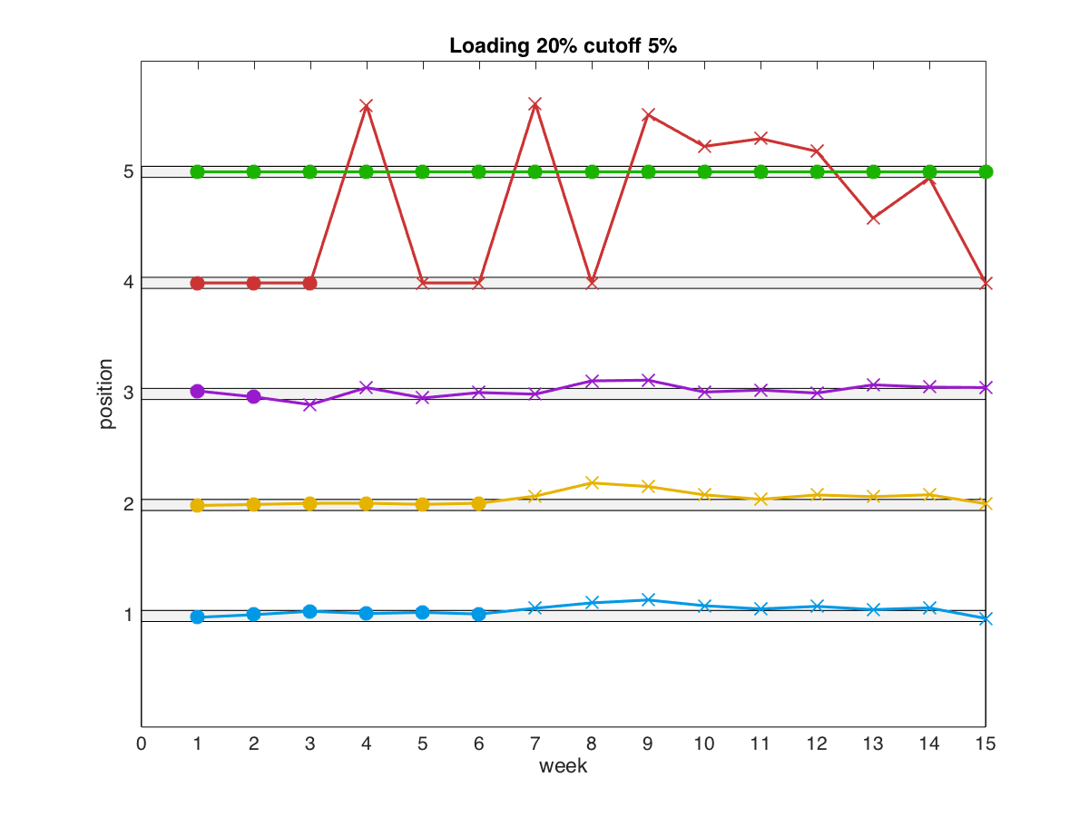
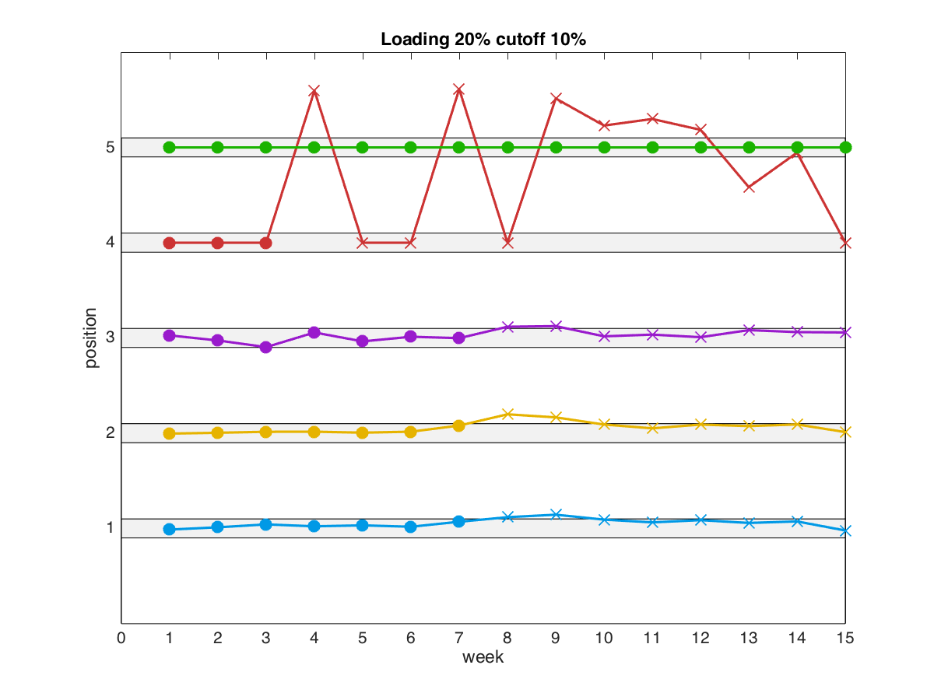
stability
cutoff 5%
cutoff 10%
5
5
4
4
position
position
3
3
2
2
1
1
week
week
position | initial | SD | week out (5%) | week out (10%)
1 | 7.30 | 0.34 | 7 | 8
2 | 3.61 | 0.22 | 7 | 8
3 | 1.98 | 0.12 | 3 | 8
4 | 0.60 | 0.42 | 4 | 4
5 | 0.60 | 0.00 | - | -

Slide 33
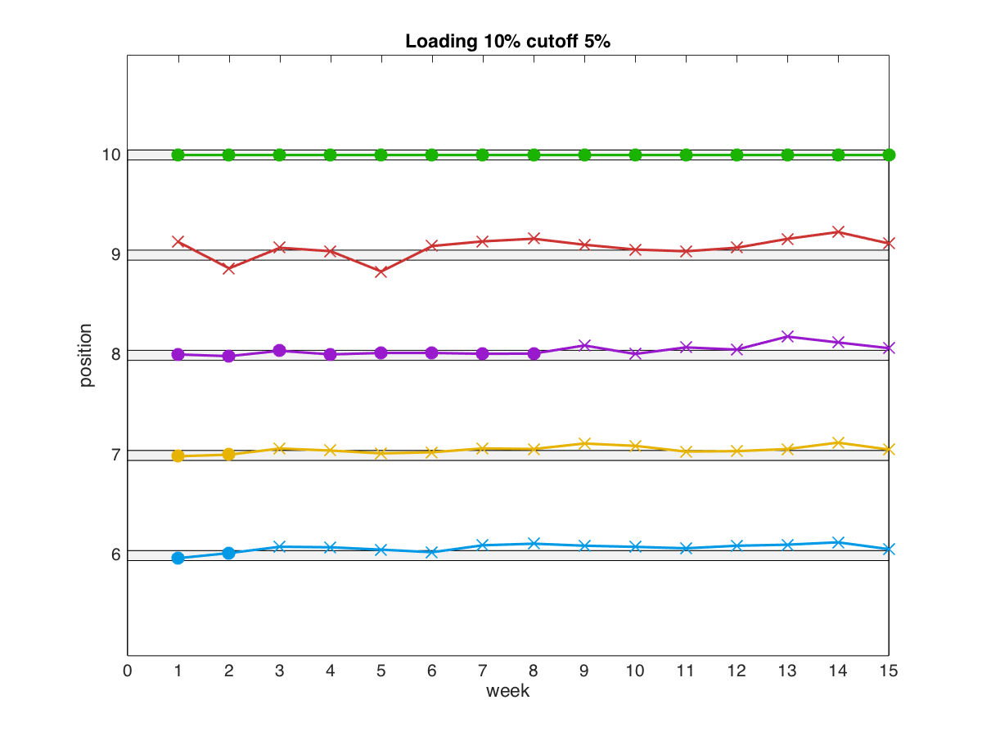
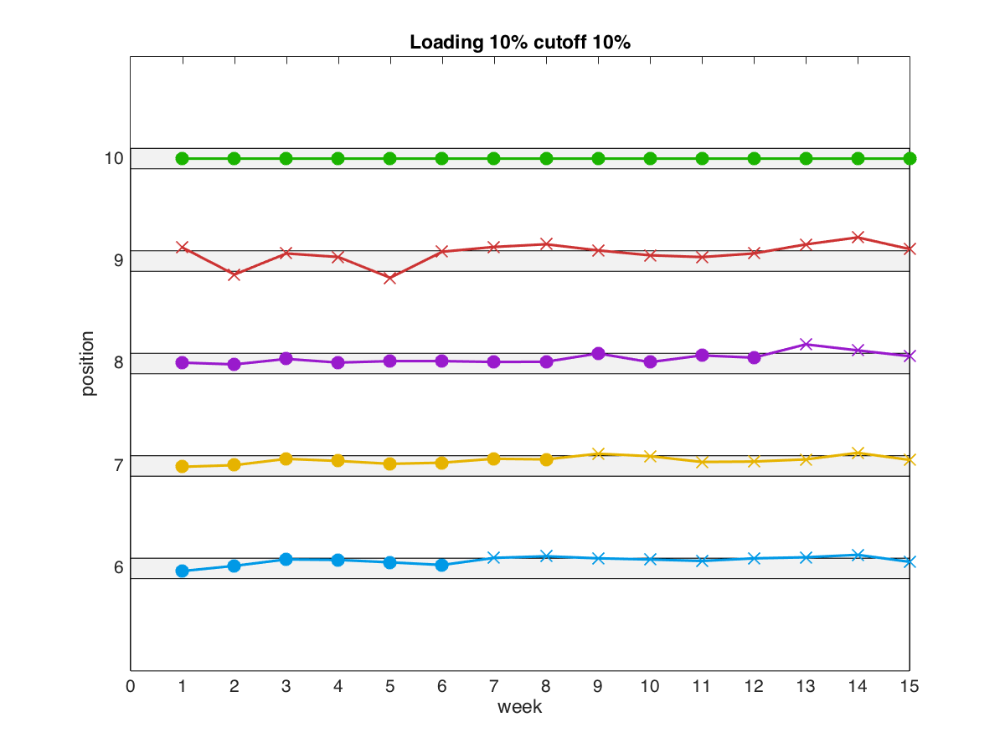
stability
stability
cutoff 5%
cutoff 10%
10
10
9
9
position
position
8
8
7
7
6
6
week
week
position | initial | SD | week out (5%) | week out (10%)
6 | 9.19 | 0.37 | 3 | 7
7 | 4.27 | 0.16 | 3 | 9
8 | 2.20 | 0.12 | 9 | 13
9 | 1.10 | 0.11 | 1 | 1
10 | 0.60 | 0.00 | - | -

Slide 34
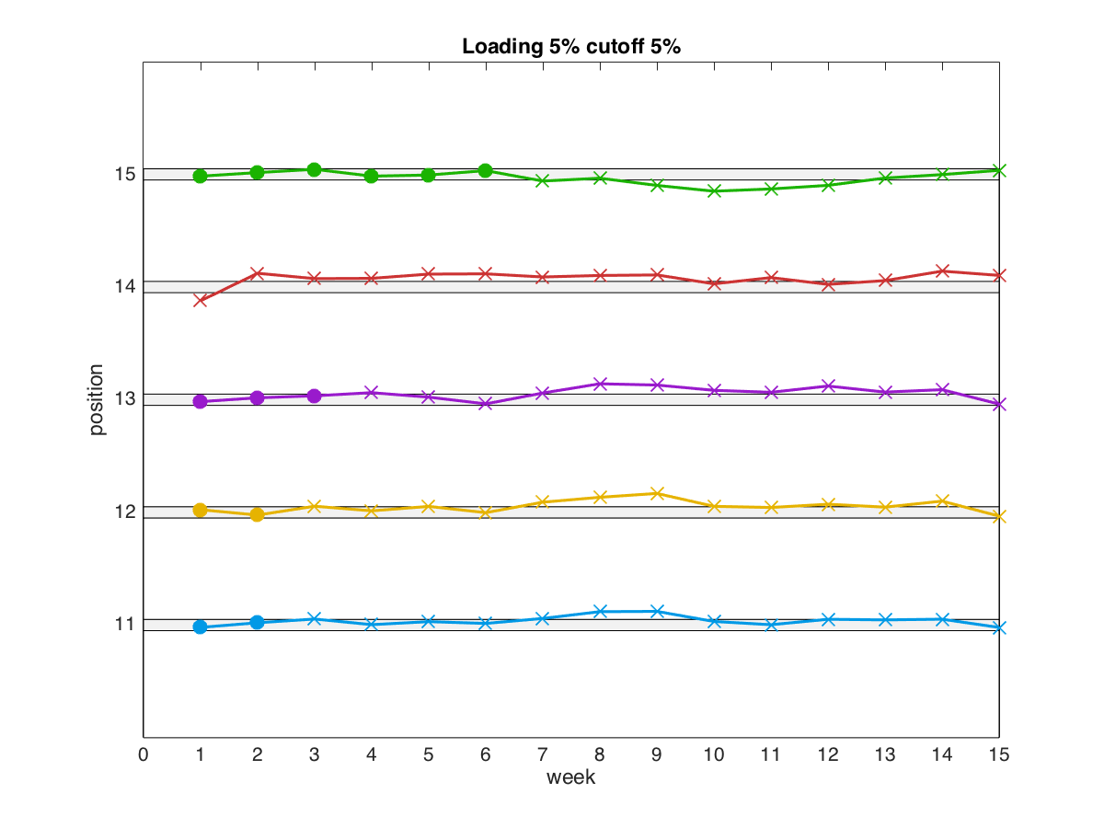
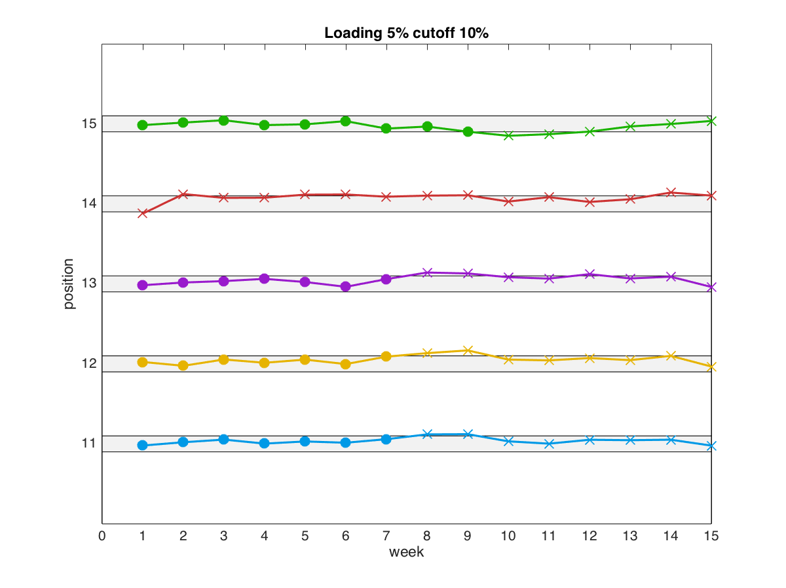
stability
stability
cutoff 5%
cutoff 10%
15
15
14
14
position
position
13
13
12
12
11
11
week
week
position | initial | SD | week out (5%) | week out (10%)
11 | 14.24 | 0.60 | 3 | 8
12 | 7.35 | 0.41 | 3 | 8
13 | 3.72 | 0.21 | 4 | 8
14 | 2.16 | 0.14 | 1 | 1
15 | 1.54 | 0.09 | 7 | 10

Slide 35
stability
position | initial | SD | week out (cutoff 5%) | week out (cutoff 10%)
1 | 7.30 | 0.34 | 7 | 8
2 | 3.61 | 0.22 | 7 | 8
3 | 1.98 | 0.12 | 3 | 8
4 | 0.60 | 0.42 | 4 | 4
5 | 0.60 | 0.00 | - | -
6 | 9.19 | 0.37 | 3 | 7
7 | 4.27 | 0.16 | 3 | 9
8 | 2.20 | 0.12 | 9 | 13
9 | 1.10 | 0.11 | 1 | 1
10 | 0.60 | 0.00 | - | -
11 | 14.24 | 0.60 | 3 | 8
12 | 7.35 | 0.41 | 3 | 8
13 | 3.72 | 0.21 | 4 | 8
14 | 2.16 | 0.14 | 1 | 1
15 | 1.54 | 0.09 | 7 | 10

Slide 43
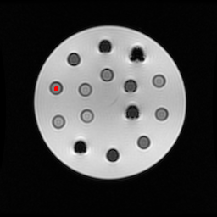
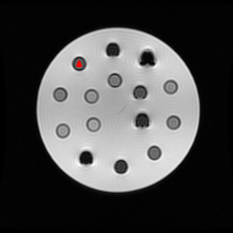
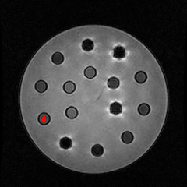
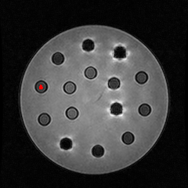
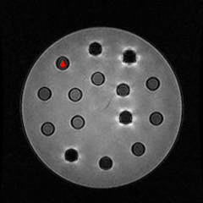
transfer roi from 1.5 to 3 Tesla

Slide 44
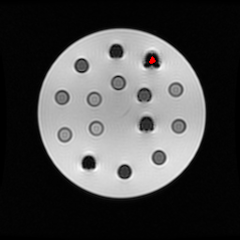
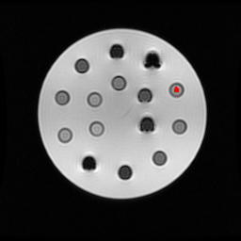
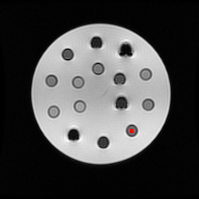
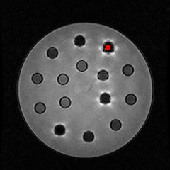
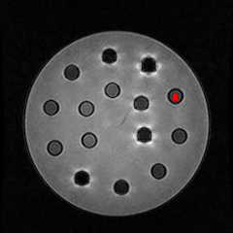
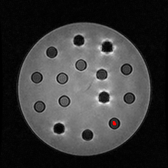
transfer roi from 1.5 to 3 Tesla

Slide 45
Correlation |  | r | n
user1 | user2 | 0.9968 | 225
user1 | user3 | 0.9908 | 255
user2 | user3 | 0.9888 | 255

Slide 46
Correlation |  | r | n
user1 | user2 | 0.9968 | 225
user1 | user3 | 0.9908 | 255
user2 | user3 | 0.9888 | 255

Slide 47
Correlation |  | r | n
user1 | user2 | 0.9968 | 225
user1 | user3 | 0.9908 | 255
user2 | user3 | 0.9888 | 255

Slide 48
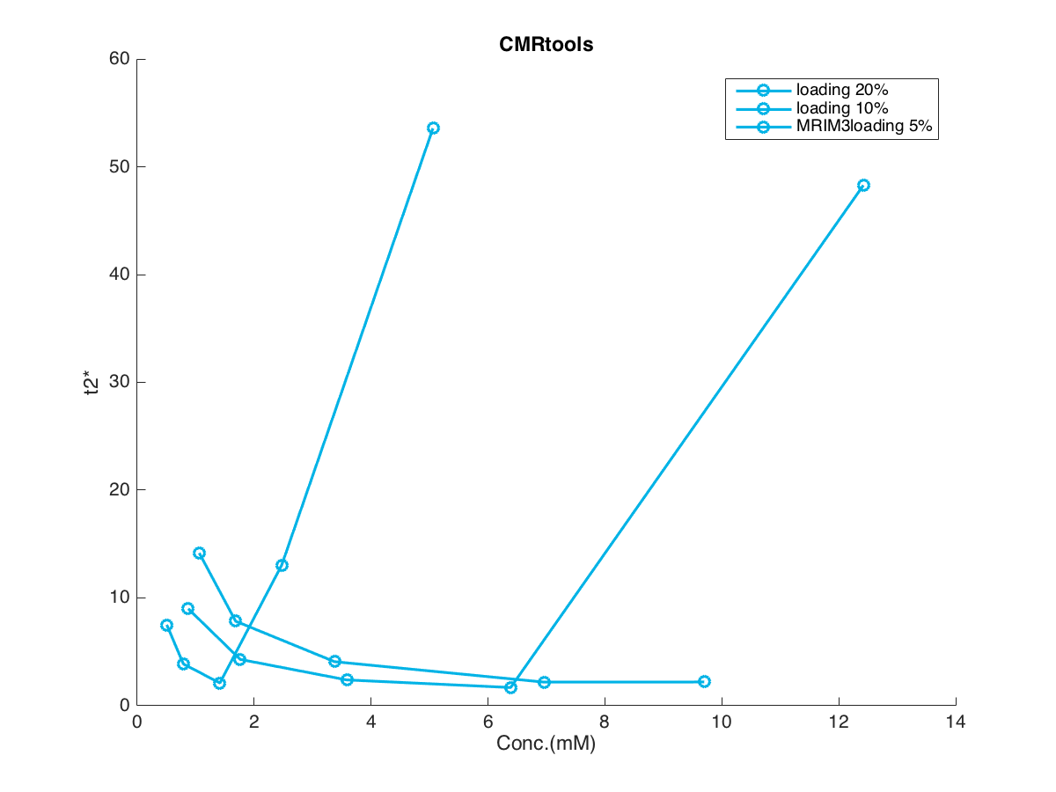
p | CMRtool | 1.5T | 3T
1 | 7.499 | 7.201 | 6.289
2 | 3.869 | 3.622 | 2.904
3 | 2.101 | 2.033 | 1.691
4 | 13.040 | 1.707 | 1.591
5 | 53.572 | 0.549 | 0.549
6 | 8.998 | 8.958 | 5.978
7 | 4.292 | 4.226 | 2.819
8 | 2.389 | 2.231 | 2.054
9 | 1.683 | 1.231 | 1.158
10 | 48.287 | 0.549 | 0.549
11 | 14.162 | 13.957 | 13.274
12 | 7.839 | 7.508 | 5.989
13 | 4.081 | 3.641 | 2.891
14 | 2.187 | 1.907 | 1.583
15 | 2.196 | 1.530 | 1.159

Slide 49

p | CMRtool | 1.5T | 3T
1 | 7.499 | 7.201 | 6.289
2 | 3.869 | 3.622 | 2.904
3 | 2.101 | 2.033 | 1.691
4 | 13.040 | 1.707 | 1.591
5 | 53.572 | 0.549 | 0.549
6 | 8.998 | 8.958 | 5.978
7 | 4.292 | 4.226 | 2.819
8 | 2.389 | 2.231 | 2.054
9 | 1.683 | 1.231 | 1.158
10 | 48.287 | 0.549 | 0.549
11 | 14.162 | 13.957 | 13.274
12 | 7.839 | 7.508 | 5.989
13 | 4.081 | 3.641 | 2.891
14 | 2.187 | 1.907 | 1.583
15 | 2.196 | 1.530 | 1.159

Slide 50

p | CMRtool | 1.5T | 3T
1 | 7.499 | 7.201 | 6.289
2 | 3.869 | 3.622 | 2.904
3 | 2.101 | 2.033 | 1.691
4 | 13.040 | 1.707 | 1.591
5 | 53.572 | 0.549 | 0.549
6 | 8.998 | 8.958 | 5.978
7 | 4.292 | 4.226 | 2.819
8 | 2.389 | 2.231 | 2.054
9 | 1.683 | 1.231 | 1.158
10 | 48.287 | 0.549 | 0.549
11 | 14.162 | 13.957 | 13.274
12 | 7.839 | 7.508 | 5.989
13 | 4.081 | 3.641 | 2.891
14 | 2.187 | 1.907 | 1.583
15 | 2.196 | 1.530 | 1.159

Slide 51

Correlation |  | r | n
CMRtools | MRIM1.5T | -0.2060 | 15
CMRtools | MRIM1.5T | 0.9993 | 12
CMRtools | MRIM 3T | -0.1671 | 15
CMRtools | MRIM 3T | 0.9826 | 12
MRIM1.5T | MRIM 3T | 0.9826 | 15

Slide 52

Correlation |  | r | n
CMRtools | MRIM1.5T | -0.2060 | 15
CMRtools | MRIM1.5T | 0.9993 | 12
CMRtools | MRIM 3T | -0.1671 | 15
CMRtools | MRIM 3T | 0.9826 | 12
MRIM1.5T | MRIM 3T | 0.9826 | 15
calculate without position 4,5,10

Slide 53

Correlation |  | r | n
CMRtools | MRIM1.5T | -0.2060 | 15
CMRtools | MRIM1.5T | 0.9993 | 12
CMRtools | MRIM 3T | -0.1671 | 15
CMRtools | MRIM 3T | 0.9826 | 12
MRIM1.5T | MRIM 3T | 0.9826 | 15

Slide 54

Correlation |  | r | n
CMRtools | MRIM1.5T | -0.2060 | 15
CMRtools | MRIM1.5T | 0.9993 | 12
CMRtools | MRIM 3T | -0.1671 | 15
CMRtools | MRIM 3T | 0.9826 | 12
MRIM1.5T | MRIM 3T | 0.9826 | 15
calculate without position 4,5,10

Slide 55

Correlation |  | r | n
CMRtools | MRIM1.5T | -0.2060 | 15
CMRtools | MRIM1.5T | 0.9993 | 12
CMRtools | MRIM 3T | -0.1671 | 15
CMRtools | MRIM 3T | 0.9826 | 12
MRIM1.5T | MRIM 3T | 0.9826 | 15

Slide 63















ตัวอย่างการวัดด้วยโปรแกรม CMRtools ของทั้ง 3 คน
Position1
Position2
Position3
Position4
Position5
User1
User2
User3

Slide 64
T2* CMRtools User1
position | 1 | 2 | 3 | 4 | 5 | 6 | 7 | 8 | 9 | 10 | 11 | 12 | 13 | 14 | 15
week1 | 7.47 | 3.86 | 2.11 | 13.25 | 54.44 | 8.99 | 4.29 | 2.39 | 1.69 | 47.03 | 14.16 | 7.83 | 4.08 | 2.18 | 2.20
week2 | 7.60 | 3.92 | 1.96 | 19.14 | 92.33 | 9.66 | 4.53 | 2.33 | 1.76 | 64.82 | 14.76 | 7.59 | 4.01 | 2.22 | 2.22
week3 | 7.99 | 3.99 | 2.07 | 18.61 | 80.75 | 10.20 | 4.76 | 2.39 | 1.70 | 54.69 | 15.15 | 7.95 | 4.17 | 2.28 | 2.80
week4 | 7.76 | 3.96 | 2.11 | 17.79 | 99.77 | 10.26 | 4.68 | 2.36 | 1.63 | 69.01 | 14.63 | 7.84 | 4.10 | 2.30 | 2.37
week5 | 7.71 | 3.96 | 2.23 | 18.55 | 90.83 | 9.99 | 4.62 | 2.39 | 1.67 | 64.20 | 14.95 | 7.92 | 4.15 | 2.45 | 2.43
week6 | 7.65 | 3.87 | 2.12 | 20.31 | 98.07 | 9.83 | 4.61 | 2.41 | 1.57 | 72.22 | 14.53 | 7.56 | 3.87 | 2.31 | 2.72
week7 | 8.03 | 4.10 | 2.20 | 15.74 | 83.79 | 10.18 | 4.77 | 2.45 | 1.64 | 69.06 | 15.18 | 8.23 | 4.26 | 2.42 | 2.10
week8 | 8.45 | 4.39 | 2.43 | 14.75 | 84.56 | 10.51 | 4.87 | 2.51 | 1.71 | 49.39 | 16.39 | 8.73 | 4.49 | 2.57 | 2.10
week9 | 8.53 | 4.44 | 2.44 | 11.79 | 87.89 | 10.27 | 4.99 | 2.55 | 1.61 | 55.73 | 16.39 | 8.84 | 4.60 | 2.61 | 1.97
week10 | 8.12 | 4.15 | 2.23 | 11.76 | 82.64 | 10.18 | 4.81 | 2.46 | 1.48 | 46.62 | 14.80 | 8.08 | 4.24 | 2.32 | 1.92
week11 | 7.98 | 4.05 | 2.18 | 2.67 | 78.90 | 10.08 | 4.63 | 2.42 | 1.45 | 40.70 | 14.82 | 8.00 | 4.20 | 2.34 | 1.95
week12 | 8.15 | 4.17 | 2.22 | 11.90 | 81.42 | 10.27 | 4.73 | 2.43 | 1.51 | 38.04 | 15.24 | 8.16 | 4.30 | 2.33 | 1.93
week13 | 7.87 | 4.14 | 2.24 | 11.95 | 60.04 | 10.41 | 4.78 | 2.63 | 1.56 | 28.21 | 15.07 | 8.07 | 4.26 | 2.37 | 2.08
week14 | 7.97 | 4.18 | 2.29 | 16.89 | 106.90 | 10.57 | 4.99 | 2.66 | 1.66 | 41.03 | 15.33 | 8.20 | 4.30 | 2.53 | 2.31
week15 | 7.42 | 3.86 | 2.16 | 19.12 | 90.14 | 10.17 | 4.66 | 2.57 | 1.48 | 49.62 | 14.01 | 7.41 | 3.85 | 2.30 | 2.60

Slide 65
T2* CMRtools User2
position | 1 | 2 | 3 | 4 | 5 | 6 | 7 | 8 | 9 | 10 | 11 | 12 | 13 | 14 | 15
week1 | 7.47 | 3.88 | 2.11 | 13.39 | 54.14 | 9.00 | 4.29 | 2.40 | 1.68 | 47.03 | 14.15 | 7.83 | 4.09 | 2.18 | 2.19
week2 | 7.58 | 3.95 | 1.96 | 18.88 | 79.90 | 9.81 | 4.50 | 2.33 | 1.76 | 64.15 | 14.91 | 7.61 | 7.61 | 2.18 | 2.78
week3 | 8.02 | 4.01 | 2.06 | 18.39 | 18.39 | 10.23 | 4.78 | 2.41 | 1.63 | 55.17 | 15.08 | 15.08 | 15.08 | 2.28 | 2.37
week4 | 7.73 | 3.95 | 2.10 | 17.99 | 89.95 | 10.31 | 4.67 | 2.34 | 1.67 | 63.10 | 14.56 | 7.78 | 4.07 | 2.32 | 2.89
week5 | 7.62 | 7.62 | 2.19 | 21.03 | 87.26 | 9.95 | 4.56 | 2.37 | 1.62 | 58.12 | 14.86 | 7.94 | 4.19 | 2.48 | 2.77
week6 | 7.62 | 3.94 | 2.13 | 20.54 | 96.02 | 9.85 | 4.55 | 2.42 | 1.51 | 67.46 | 14.49 | 7.50 | 3.89 | 2.46 | 3.19
week7 | 7.97 | 4.10 | 2.19 | 16.17 | 91.10 | 10.21 | 4.69 | 2.41 | 1.70 | 66.28 | 15.13 | 8.15 | 4.28 | 2.53 | 2.54
week8 | 8.47 | 4.34 | 2.35 | 14.43 | 86.91 | 10.56 | 4.81 | 2.49 | 1.59 | 50.29 | 16.33 | 8.65 | 4.49 | 2.60 | 2.17
week9 | 8.50 | 4.43 | 2.40 | 13.42 | 83.01 | 10.32 | 4.93 | 2.55 | 1.57 | 49.85 | 16.44 | 8.88 | 4.61 | 2.67 | 2.05
week10 | 8.05 | 4.12 | 2.21 | 12.63 | 73.54 | 10.16 | 4.76 | 2.44 | 1.47 | 43.27 | 14.75 | 8.04 | 4.27 | 2.40 | 2.05
week11 | 7.99 | 4.07 | 2.16 | 10.07 | 82.51 | 10.15 | 4.66 | 2.44 | 1.45 | 40.07 | 14.82 | 8.03 | 4.25 | 2.32 | 2.19
week12 | 8.12 | 4.17 | 2.17 | 13.54 | 79.36 | 10.29 | 4.65 | 2.41 | 1.45 | 40.25 | 15.16 | 8.17 | 4.32 | 2.39 | 2.13
week13 | 7.85 | 4.14 | 2.25 | 12.36 | 60.31 | 10.37 | 4.76 | 2.62 | 1.57 | 31.02 | 15.05 | 8.08 | 4.24 | 2.32 | 2.19
week14 | 7.97 | 4.16 | 2.28 | 16.03 | 101.04 | 10.57 | 4.99 | 2.64 | 1.62 | 39.54 | 15.33 | 8.21 | 4.29 | 2.55 | 2.32
week15 | 7.39 | 3.87 | 2.17 | 19.44 | 85.09 | 10.14 | 4.72 | 2.57 | 1.51 | 42.12 | 14.05 | 7.41 | 3.82 | 2.37 | 3.33

Slide 66
T2* CMRtools User3
position | 1 | 2 | 3 | 4 | 5 | 6 | 7 | 8 | 9 | 10 | 11 | 12 | 13 | 14 | 15
week1 | 7.55 | 3.87 | 2.09 | 12.48 | 52.14 | 9.00 | 4.29 | 2.38 | 1.67 | 50.80 | 14.17 | 7.85 | 4.06 | 2.20 | 2.20
week2 | 7.58 | 3.95 | 1.95 | 20.56 | 88.36 | 9.62 | 4.52 | 2.31 | 1.76 | 1.76 | 14.78 | 7.65 | 4.05 | 2.27 | 2.72
week3 | 8.04 | 4.00 | 2.07 | 19.96 | 70.49 | 10.21 | 4.77 | 2.40 | 1.61 | 55.99 | 15.23 | 8.00 | 4.21 | 2.29 | 3.08
week4 | 7.81 | 3.97 | 2.16 | 20.23 | 97.95 | 10.26 | 4.67 | 2.36 | 1.70 | 77.48 | 14.67 | 7.87 | 4.16 | 2.33 | 2.58
week5 | 7.72 | 3.94 | 2.24 | 19.66 | 118.88 | 9.93 | 4.59 | 2.38 | 11.97 | 72.10 | 14.97 | 7.97 | 4.16 | 2.48 | 2.30
week6 | 7.66 | 3.93 | 2.15 | 21.79 | 93.00 | 9.77 | 4.56 | 2.41 | 1.57 | 73.80 | 14.60 | 7.60 | 3.89 | 2.38 | 2.61
week7 | 8.04 | 4.14 | 2.20 | 15.91 | 87.09 | 10.15 | 4.76 | 2.43 | 1.74 | 74.78 | 15.31 | 8.24 | 4.29 | 2.49 | 2.10
week8 | 8.46 | 4.38 | 2.45 | 14.87 | 80.09 | 10.51 | 4.85 | 2.49 | 1.69 | 52.99 | 16.42 | 8.76 | 4.52 | 2.63 | 2.10
week9 | 8.55 | 4.46 | 2.46 | 12.41 | 83.58 | 10.29 | 5.03 | 2.56 | 1.59 | 55.75 | 16.42 | 8.93 | 4.61 | 2.64 | 1.80
week10 | 8.07 | 4.14 | 2.23 | 12.99 | 78.41 | 10.14 | 4.81 | 2.44 | 1.49 | 51.64 | 14.87 | 8.07 | 4.23 | 2.40 | 1.90
week11 | 8.01 | 4.06 | 2.19 | 10.69 | 82.37 | 10.05 | 4.63 | 2.41 | 1.43 | 45.44 | 14.86 | 8.02 | 4.26 | 2.42 | 1.81
week12 | 8.15 | 4.17 | 2.16 | 14.27 | 84.62 | 10.25 | 4.70 | 2.41 | 1.43 | 40.96 | 15.29 | 8.20 | 4.33 | 2.43 | 1.91
week13 | 7.86 | 4.15 | 2.27 | 13.94 | 55.89 | 10.34 | 4.74 | 2.61 | 1.55 | 28.80 | 15.14 | 8.07 | 4.26 | 2.49 | 2.10
week14 | 8.05 | 4.20 | 2.23 | 13.75 | 83.00 | 10.74 | 5.07 | 2.66 | 1.61 | 32.09 | 15.20 | 8.23 | 4.29 | 2.50 | 2.12
week15 | 7.40 | 3.89 | 2.16 | 17.49 | 85.42 | 10.07 | 4.67 | 2.57 | 1.53 | 51.52 | 14.12 | 7.48 | 3.90 | 2.29 | 2.60

Slide 67

T2* Value
loading 5%
position | User1 | User2 | User3
1 | 7.47 | 7.47 | 7.55
2 | 3.86 | 3.88 | 3.87
3 | 2.11 | 2.11 | 2.09
4 | 13.25 | 13.39 | 12.48
5 | 54.44 | 54.14 | 52.14
6 | 8.99 | 9.00 | 9.00
7 | 4.29 | 4.29 | 4.29
8 | 2.39 | 2.40 | 2.38
9 | 1.69 | 1.68 | 1.67
10 | 47.03 | 47.03 | 50.80
11 | 14.16 | 14.15 | 14.17
12 | 7.83 | 7.83 | 7.85
13 | 4.08 | 4.09 | 4.06
14 | 2.18 | 2.18 | 2.20
15 | 2.20 | 2.19 | 2.20
loading 20%
loading 10%
position | 1 | 2 | 3 | 4 | 5 | 6 | 7 | 8 | 9 | 10 | 11 | 12 | 13 | 14 | 15
mean | 7.50 | 3.87 | 2.10 | 13.04 | 53.57 | 9.00 | 4.29 | 2.39 | 1.68 | 48.29 | 14.16 | 7.84 | 4.08 | 2.19 | 2.20
SD | 0.47 | 0.08 | 0.11 | 4.94 | 12.53 | 0.10 | 0.03 | 0.10 | 0.11 | 21.75 | 0.06 | 0.13 | 0.15 | 0.14 | 0.05

Slide 68

T2* Value
loading 5%
position | User1 | User2 | User3
1 | 7.60 | 7.58 | 7.58
2 | 3.92 | 3.95 | 3.95
3 | 1.96 | 1.96 | 1.95
4 | 19.14 | 18.88 | 20.56
5 | 92.33 | 79.90 | 88.36
6 | 9.66 | 9.81 | 9.62
7 | 4.53 | 4.50 | 4.52
8 | 2.33 | 2.33 | 2.31
9 | 1.76 | 1.76 | 1.76
10 | 64.82 | 64.15 | 1.76
11 | 14.76 | 14.91 | 14.78
12 | 7.59 | 7.61 | 7.65
13 | 4.01 | 7.61 | 4.05
14 | 2.22 | 2.18 | 2.27
15 | 2.22 | 2.78 | 2.72
loading 20%
loading 10%
position | 1 | 2 | 3 | 4 | 5 | 6 | 7 | 8 | 9 | 10 | 11 | 12 | 13 | 14 | 15
mean | 7.59 | 3.94 | 1.96 | 19.53 | 86.87 | 9.70 | 4.52 | 2.32 | 1.76 | 43.57 | 14.81 | 7.62 | 5.22 | 2.22 | 2.57
SD | 0.11 | 0.14 | 0.06 | 9.04 | 63.46 | 1.01 | 0.14 | 0.11 | 0.03 | 362.16 | 0.81 | 0.34 | 20.64 | 0.49 | 3.08

Slide 69

T2* Value
loading 5%
position | User1 | User2 | User3
1 | 7.99 | 8.02 | 8.04
2 | 3.99 | 4.01 | 4.00
3 | 2.07 | 2.06 | 2.07
4 | 18.61 | 18.39 | 19.96
5 | 80.75 | 18.39 | 70.49
6 | 10.20 | 10.23 | 10.21
7 | 4.76 | 4.78 | 4.77
8 | 2.39 | 2.41 | 2.40
9 | 1.70 | 1.63 | 1.61
10 | 54.69 | 55.17 | 55.99
11 | 15.15 | 15.08 | 15.23
12 | 7.95 | 15.08 | 8.00
13 | 4.17 | 15.08 | 4.21
14 | 2.28 | 2.28 | 2.29
15 | 2.80 | 2.37 | 3.08
loading 20%
loading 10%
position | 1 | 2 | 3 | 4 | 5 | 6 | 7 | 8 | 9 | 10 | 11 | 12 | 13 | 14 | 15
mean | 8.02 | 4.00 | 2.06 | 18.99 | 56.54 | 10.21 | 4.77 | 2.40 | 1.65 | 55.28 | 15.15 | 10.34 | 7.82 | 2.28 | 2.75
SD | 0.23 | 0.09 | 0.06 | 8.50 | 334.36 | 0.14 | 0.10 | 0.11 | 0.45 | 6.60 | 0.74 | 41.05 | 62.87 | 0.09 | 3.57

Slide 70
เพิ่มเงื่อนไขตรวจสอบค่า T2*
การตรวขสอบว่าค่า T2* ที่ได้ถูกต้องหรือไม่
1. ค่า ratio ต้องมีค่าต่ำกว่า 0.317
2. ค่า T2* ต้องไม่ติดลบ
ถ้าไม่ถูกต้องจะกำหนดให้ค่า T2* มีค่าต่ำกว่า 1.097 โดยกำหนดให้มีค่าเท่ากับ 0.549 เพื่อง่ายแก่การ plot chart

Slide 71
Result
1.5Tesla CMRtools Result
date | T2* value
 | position1 | position2 | position3 | position4 | position5 | position6 | position7 | position8 | position9 | position10 | position11 | position12 | position13 | position14 | position15
2014-09-30' | 7.472 | 3.860 | 2.094 | 12.325 | 55.463 | 8.954 | 4.320 | 2.377 | 1.683 | 51.289 | 14.185 | 7.781 | 4.056 | 2.160 | 2.079
2014-10-08' | 7.617 | 3.926 | 1.958 | 17.812 | 88.170 | 9.677 | 4.505 | 2.350 | 1.802 | 63.018 | 14.653 | 7.503 | 3.959 | 2.077 | 2.714
2014-10-15' | 8.033 | 4.015 | 2.069 | 17.659 | 82.364 | 10.235 | 4.758 | 2.418 | 1.638 | 55.377 | 15.233 | 7.933 | 4.152 | 2.170 | 2.612
2014-10-22' | 7.733 | 3.981 | 2.103 | 16.333 | 99.779 | 10.323 | 4.708 | 2.386 | 1.673 | 64.793 | 14.631 | 7.857 | 4.067 | 2.199 | 2.391
2014-11-05' | 7.672 | 3.933 | 2.198 | 19.128 | 98.721 | 10.082 | 4.626 | 2.408 | 1.727 | 58.036 | 14.813 | 7.833 | 4.088 | 2.328 | 2.294
2014-11-12' | 7.579 | 3.885 | 2.129 | 19.123 | 104.508 | 9.946 | 4.633 | 2.417 | 1.575 | 69.908 | 14.425 | 7.528 | 3.844 | 2.228 | 2.726
2014-11-19' | 7.957 | 4.128 | 2.162 | 14.417 | 90.513 | 10.242 | 4.753 | 2.462 | 1.727 | 62.562 | 15.178 | 8.150 | 4.178 | 2.299 | 2.309
2014-11-26' | 8.363 | 4.320 | 2.316 | 13.467 | 89.903 | 10.683 | 4.893 | 2.554 | 1.668 | 49.213 | 16.303 | 8.689 | 4.442 | 2.444 | 2.114
2014-12-03' | 8.453 | 4.375 | 2.384 | 11.064 | 83.863 | 10.372 | 5.004 | 2.571 | 1.617 | 49.300 | 16.338 | 8.792 | 4.517 | 2.456 | 1.910
2014-12-10' | 8.037 | 4.180 | 2.196 | 8.043 | 79.613 | 10.233 | 4.773 | 2.530 | 1.490 | 42.714 | 14.799 | 8.030 | 4.195 | 2.248 | 1.818
2014-12-17' | 7.981 | 4.110 | 2.192 | 2.392 | 88.821 | 10.259 | 4.673 | 2.466 | 1.487 | 40.002 | 14.936 | 8.020 | 4.148 | 2.187 | 1.769
2014-12-24' | 8.146 | 4.167 | 2.197 | 12.296 | 70.749 | 10.327 | 4.750 | 2.466 | 1.527 | 36.942 | 15.194 | 8.184 | 4.206 | 2.260 | 1.919
2015-01-21' | 7.914 | 4.166 | 2.260 | 9.619 | 60.496 | 10.507 | 4.804 | 2.636 | 1.609 | 27.603 | 15.063 | 8.042 | 4.184 | 2.257 | 1.819
2015-01-28' | 7.981 | 4.216 | 2.304 | 14.208 | 112.086 | 10.664 | 4.980 | 2.663 | 1.671 | 40.998 | 15.403 | 8.218 | 4.290 | 2.334 | 2.053
2015-02-04' | 7.421 | 3.892 | 2.169 | 18.980 | 101.124 | 10.182 | 4.718 | 2.596 | 1.597 | 46.076 | 14.100 | 7.394 | 3.805 | 2.185 | 2.540
mean | 7.891 | 4.077 | 2.182 | 13.791 | 87.078 | 10.179 | 4.727 | 2.487 | 1.633 | 50.522 | 15.017 | 7.997 | 4.142 | 2.256 | 2.205

Slide 72
Result
1.5Tesla MRIM Result
date | T2* value
 | position1 | position2 | position3 | position4 | position5 | position6 | position7 | position8 | position9 | position10 | position11 | position12 | position13 | position14 | position15
2014-09-30' | 7.207 | 3.644 | 2.031 | 1.807 | 0.549 | 8.906 | 4.248 | 2.207 | 1.316 | 0.549 | 13.905 | 7.425 | 3.701 | 1.891 | 1.487
2014-10-08' | 7.440 | 3.686 | 1.868 | 1.494 | 0.549 | 9.271 | 4.253 | 2.245 | 1.242 | 0.549 | 14.382 | 7.053 | 3.633 | 2.431 | 1.636
2014-10-15' | 7.741 | 3.705 | 1.826 | 1.620 | 0.549 | 10.015 | 4.431 | 2.333 | 1.209 | 0.549 | 15.131 | 7.572 | 3.778 | 2.394 | 1.628
2014-10-22' | 7.449 | 3.685 | 2.054 | 1.691 | 0.549 | 9.890 | 4.370 | 2.294 | 1.110 | 0.549 | 14.322 | 7.463 | 3.910 | 1.869 | 1.514
2014-11-05' | 7.494 | 3.679 | 1.936 | 1.637 | 0.549 | 9.629 | 4.454 | 2.337 | 1.158 | 0.549 | 14.522 | 7.408 | 3.651 | 1.896 | 1.580
2014-11-12' | 7.420 | 3.680 | 2.020 | 1.773 | 0.549 | 9.539 | 4.556 | 2.339 | 1.136 | 0.549 | 14.363 | 7.281 | 3.583 | 2.443 | 1.600
2014-11-19' | 7.795 | 3.904 | 1.906 | 1.564 | 0.549 | 9.954 | 4.456 | 2.297 | 1.212 | 0.549 | 14.953 | 7.803 | 3.924 | 1.975 | 1.536
2014-11-26' | 8.149 | 4.043 | 2.040 | 1.434 | 0.549 | 10.152 | 4.545 | 2.374 | 1.247 | 0.549 | 15.928 | 8.268 | 4.098 | 2.402 | 1.507
2014-12-03' | 8.297 | 4.070 | 2.028 | 1.422 | 0.549 | 10.086 | 4.861 | 2.437 | 1.205 | 0.549 | 16.331 | 8.506 | 4.224 | 2.376 | 1.407
2014-12-10' | 7.919 | 3.933 | 1.910 | 1.312 | 0.549 | 9.950 | 4.529 | 2.388 | 1.174 | 0.549 | 14.711 | 7.678 | 3.809 | 2.144 | 1.370
2014-12-17' | 7.670 | 3.858 | 1.889 | 1.332 | 0.549 | 9.997 | 4.486 | 2.430 | 1.184 | 0.549 | 14.873 | 7.730 | 3.954 | 2.128 | 1.395
2014-12-24' | 7.901 | 3.911 | 1.907 | 1.264 | 0.549 | 9.937 | 4.445 | 2.397 | 1.206 | 2.037 | 14.909 | 7.770 | 4.026 | 2.163 | 1.448
2015-01-21' | 7.647 | 3.970 | 2.091 | 1.286 | 0.549 | 10.280 | 4.693 | 2.647 | 1.332 | 1.867 | 14.823 | 7.585 | 3.968 | 2.198 | 1.396
2015-01-28' | 7.934 | 3.952 | 2.072 | 1.489 | 0.549 | 10.348 | 4.700 | 2.542 | 1.353 | 0.549 | 15.234 | 7.839 | 3.932 | 1.935 | 1.503
2015-02-04' | 7.360 | 3.680 | 2.011 | 1.643 | 0.549 | 9.854 | 4.478 | 2.440 | 1.258 | 0.549 | 14.090 | 7.040 | 3.472 | 1.807 | 1.568
mean | 7.695 | 3.827 | 1.973 | 1.518 | 0.549 | 9.854 | 4.500 | 2.380 | 1.223 | 0.736 | 14.832 | 7.628 | 3.844 | 2.137 | 1.505
T2* value on table = 0.549 mean T2* value less than 1.097

Slide 73
Result
3Tesla MRIM Result
date | T2* value
 | position1 | position2 | position3 | position4 | position5 | position6 | position7 | position8 | position9 | position10 | position11 | position12 | position13 | position14 | position15
2014-09-30' | 5.459 | 2.864 | 1.771 | 1.565 | 0.549 | 6.624 | 2.949 | 2.036 | 1.094 | 0.549 | 17.389 | 5.914 | 2.998 | 1.643 | 1.146
2014-10-08' | 6.507 | 3.523 | 1.473 | 1.668 | 0.549 | 9.287 | 3.907 | 2.196 | 0.549 | 0.549 | 11.171 | 6.314 | 3.987 | 1.089 | 1.140
2014-10-15' | 6.835 | 3.586 | 1.500 | 1.635 | 0.549 | 8.497 | 4.231 | 2.183 | 1.175 | 0.549 | 15.874 | 6.909 | 3.780 | 1.196 | 1.184
2014-10-22' | 6.872 | 3.590 | 1.692 | 1.606 | 0.549 | 8.660 | 3.623 | 2.074 | 1.128 | 0.549 | 12.666 | 6.640 | 3.965 | 1.421 | 0.967
2014-11-05' | 7.808 | 3.479 | 1.372 | 0.549 | 0.549 | 10.816 | 4.965 | 1.849 | 1.210 | 0.549 | 13.094 | 6.346 | 3.833 | 1.617 | 1.606
2014-11-12' | 6.508 | 3.240 | 0.992 | 0.549 | 0.549 | 8.857 | 5.048 | 1.926 | 1.262 | 0.549 | 9.919 | 5.560 | 3.227 | 1.476 | 1.542
2014-11-19' | 7.081 | 3.449 | 1.341 | 1.388 | 0.549 | 8.231 | 3.930 | 2.170 | 0.921 | 0.549 | 10.281 | 6.108 | 3.762 | 1.428 | 1.488
2014-11-26' | 8.647 | 3.762 | 1.487 | 1.051 | 0.549 | 11.591 | 4.985 | 1.600 | 1.139 | 0.549 | 17.732 | 6.961 | 3.986 | 1.752 | 1.064
2014-12-03' | 7.376 | 3.595 | 1.374 | 1.054 | 0.549 | 6.210 | 3.464 | 1.662 | 0.927 | 0.549 | 9.666 | 6.228 | 3.389 | 1.631 | 1.049
2014-12-10' | 5.453 | 3.291 | 1.083 | 2.139 | 0.549 | 8.525 | 3.233 | 1.549 | 1.175 | 0.549 | 7.174 | 5.065 | 2.655 | 1.741 | 1.792
2014-12-17' | 6.116 | 3.445 | 1.362 | 0.916 | 0.549 | 12.673 | 3.281 | 1.619 | 0.856 | 0.549 | 10.074 | 6.209 | 3.380 | 1.407 | 1.129
2014-12-24' | 6.615 | 3.417 | 1.217 | 1.280 | 0.549 | 10.846 | 4.021 | 1.917 | 1.173 | 0.549 | 10.913 | 6.507 | 3.741 | 1.446 | 1.434
2015-01-21' | 7.199 | 3.438 | 1.342 | 1.338 | 0.549 | 11.279 | 4.105 | 1.766 | 1.018 | 0.549 | 12.445 | 6.544 | 3.459 | 1.589 | 1.121
2015-01-28' | 6.797 | 3.418 | 1.250 | 0.801 | 0.549 | 8.200 | 3.441 | 1.702 | 1.065 | 0.868 | 12.581 | 6.258 | 3.443 | 1.745 | 0.913
2015-02-04' | 5.430 | 3.816 | 1.472 | 0.549 | 0.549 | 11.056 | 3.157 | 2.054 | 1.183 | 0.549 | 10.160 | 6.081 | 3.768 | 1.334 | 1.297
mean | 6.714 | 3.461 | 1.382 | 1.206 | 0.549 | 9.423 | 3.889 | 1.887 | 1.058 | 0.570 | 12.076 | 6.243 | 3.558 | 1.501 | 1.258
T2* value on table = 0.549 mean T2* value less than 1.097

Slide 74

posi tion | T2* mean value |  |  | Conc.
 | CMRtools | 1.5T | 3T
1 | 7.891 | 7.695 | 6.714 | 0.505
2 | 4.077 | 3.827 | 3.461 | 0.789
3 | 2.182 | 1.973 | 1.382 | 1.413
4 | 13.791 | 1.518 | 1.206 | 2.470
5 | 87.078 | 0.549 | 0.549 | 5.059
6 | 10.179 | 9.854 | 9.423 | 0.871
7 | 4.727 | 4.500 | 3.889 | 1.761
8 | 2.487 | 2.380 | 1.887 | 3.584
9 | 1.633 | 1.223 | 1.058 | 6.387
10 | 50.522 | 0.736 | 0.570 | 12.421
11 | 15.017 | 14.832 | 12.076 | 1.060
12 | 7.997 | 7.628 | 6.243 | 1.682
13 | 4.142 | 3.844 | 3.558 | 3.375
14 | 2.256 | 2.137 | 1.501 | 6.956
15 | 2.205 | 1.505 | 1.258 | 9.698
set1 loading 20%

Slide 75

posi tion | T2* mean value |  |  | Conc.
 | CMRtools | 1.5T | 3T
1 | 7.891 | 7.695 | 6.714 | 0.505
2 | 4.077 | 3.827 | 3.461 | 0.789
3 | 2.182 | 1.973 | 1.382 | 1.413
4 | 13.791 | 1.518 | 1.206 | 2.470
5 | 87.078 | 0.549 | 0.549 | 5.059
6 | 10.179 | 9.854 | 9.423 | 0.871
7 | 4.727 | 4.500 | 3.889 | 1.761
8 | 2.487 | 2.380 | 1.887 | 3.584
9 | 1.633 | 1.223 | 1.058 | 6.387
10 | 50.522 | 0.736 | 0.570 | 12.421
11 | 15.017 | 14.832 | 12.076 | 1.060
12 | 7.997 | 7.628 | 6.243 | 1.682
13 | 4.142 | 3.844 | 3.558 | 3.375
14 | 2.256 | 2.137 | 1.501 | 6.956
15 | 2.205 | 1.505 | 1.258 | 9.698
set2 loading 10%

Slide 76

posi tion | T2* mean value |  |  | Conc.
 | CMRtools | 1.5T | 3T
1 | 7.891 | 7.695 | 6.714 | 0.505
2 | 4.077 | 3.827 | 3.461 | 0.789
3 | 2.182 | 1.973 | 1.382 | 1.413
4 | 13.791 | 1.518 | 1.206 | 2.470
5 | 87.078 | 0.549 | 0.549 | 5.059
6 | 10.179 | 9.854 | 9.423 | 0.871
7 | 4.727 | 4.500 | 3.889 | 1.761
8 | 2.487 | 2.380 | 1.887 | 3.584
9 | 1.633 | 1.223 | 1.058 | 6.387
10 | 50.522 | 0.736 | 0.570 | 12.421
11 | 15.017 | 14.832 | 12.076 | 1.060
12 | 7.997 | 7.628 | 6.243 | 1.682
13 | 4.142 | 3.844 | 3.558 | 3.375
14 | 2.256 | 2.137 | 1.501 | 6.956
15 | 2.205 | 1.505 | 1.258 | 9.698
set3 loading 5%

Slide 77





T2* = 7.207
T2* = 5.459
T2* = 7.47
MRIM 3T
CMRtools 1.5T
MRIM 1.5T
position 1 Conc. 0.505

Slide 78





T2* = 3.644
T2* = 2.864
T2* = 3.86
MRIM 3T
CMRtools 1.5T
MRIM 1.5T
position 2 Conc. 0.789

Slide 79





T2* = 2.031
T2* = 1.771
T2* = 2.09
MRIM 3T
CMRtools 1.5T
MRIM 1.5T
position 3 Conc. 1.413

Slide 80





T2* = 1.807
T2* = 1.565
T2* = 12.32
MRIM 3T
CMRtools 1.5T
MRIM 1.5T
position 4 Conc. 2.470

Slide 81





T2* = 0.549
T2* = 0.549
T2* = 55.46
MRIM 3T
CMRtools 1.5T
MRIM 1.5T
position 5 Conc. 5.059

Slide 82

posi tion | T2* mean value |  | Conc.
 | CMRtools | 1.5T
1 | 7.891 | 7.695 | 0.505
2 | 4.077 | 3.827 | 0.789
3 | 2.182 | 1.973 | 1.413
4 | 13.791 | 1.518 | 2.470
5 | 87.078 | 0.549 | 5.059
6 | 10.179 | 9.854 | 0.871
7 | 4.727 | 4.500 | 1.761
8 | 2.487 | 2.380 | 3.584
9 | 1.633 | 1.223 | 6.387
10 | 50.522 | 0.736 | 12.421
11 | 15.017 | 14.832 | 1.060
12 | 7.997 | 7.628 | 1.682
13 | 4.142 | 3.844 | 3.375
14 | 2.256 | 2.137 | 6.956
15 | 2.205 | 1.505 | 9.698

Slide 83

posi tion | T2* mean value |  | Conc.
 | CMRtools | 3T
1 | 7.891 | 6.714 | 0.505
2 | 4.077 | 3.461 | 0.789
3 | 2.182 | 1.382 | 1.413
4 | 13.791 | 1.206 | 2.470
5 | 87.078 | 0.549 | 5.059
6 | 10.179 | 9.423 | 0.871
7 | 4.727 | 3.889 | 1.761
8 | 2.487 | 1.887 | 3.584
9 | 1.633 | 1.058 | 6.387
10 | 50.522 | 0.570 | 12.421
11 | 15.017 | 12.076 | 1.060
12 | 7.997 | 6.243 | 1.682
13 | 4.142 | 3.558 | 3.375
14 | 2.256 | 1.501 | 6.956
15 | 2.205 | 1.258 | 9.698

Slide 84


posi tion | T2* mean value |  | Conc.
 | 1.5T | 3T
1 | 7.695 | 6.714 | 0.505
2 | 3.827 | 3.461 | 0.789
3 | 1.973 | 1.382 | 1.413
4 | 1.518 | 1.206 | 2.470
5 | 0.549 | 0.549 | 5.059
6 | 9.854 | 9.423 | 0.871
7 | 4.500 | 3.889 | 1.761
8 | 2.380 | 1.887 | 3.584
9 | 1.223 | 1.058 | 6.387
10 | 0.736 | 0.570 | 12.421
11 | 14.832 | 12.076 | 1.060
12 | 7.628 | 6.243 | 1.682
13 | 3.844 | 3.558 | 3.375
14 | 2.137 | 1.501 | 6.956
15 | 1.505 | 1.258 | 9.698

Slide 85
Correlation Between |  | r | n
CMRtools | MRIM 1.5T | 0.9993 | 12
CMRtools | MRIM 3T | 0.9938 | 12
MRIM 1.5T | MRIM 3T | 0.9936 | 12*
MRIM 1.5T | MRIM 3T | 0.9947 | 15
*ตัด position ตาม CMRtool ที่ให้ผล error

Slide 86

MRIM 1.5Tesla T2* Result
posi tion | T2* mean value | Conc. | loading
1 | 7.695 | 0.505 | 20%
2 | 3.827 | 0.789
3 | 1.973 | 1.413
4 | 1.518 | 2.470
5 | 0.549 | 5.059
6 | 9.854 | 0.871 | 10%
7 | 4.500 | 1.761
8 | 2.380 | 3.584
9 | 1.223 | 6.387
10 | 0.736 | 12.421
11 | 14.832 | 1.060 | 5%
12 | 7.628 | 1.682
13 | 3.844 | 3.375
14 | 2.137 | 6.956
15 | 1.505 | 9.698
loading 5%
loading 20%
loading 10%

Slide 87


MRIM 1.5Tesla T2* Result
loading 5%
loading 20%
loading 10%

Slide 88

MRIM 1.5Tesla R2* Result
loading 20%
loading 10%
loading 5%

Slide 89

MRIM 1.5Tesla R2* Result
loading 20%
loading 10%
loading 5%

